Slide 1
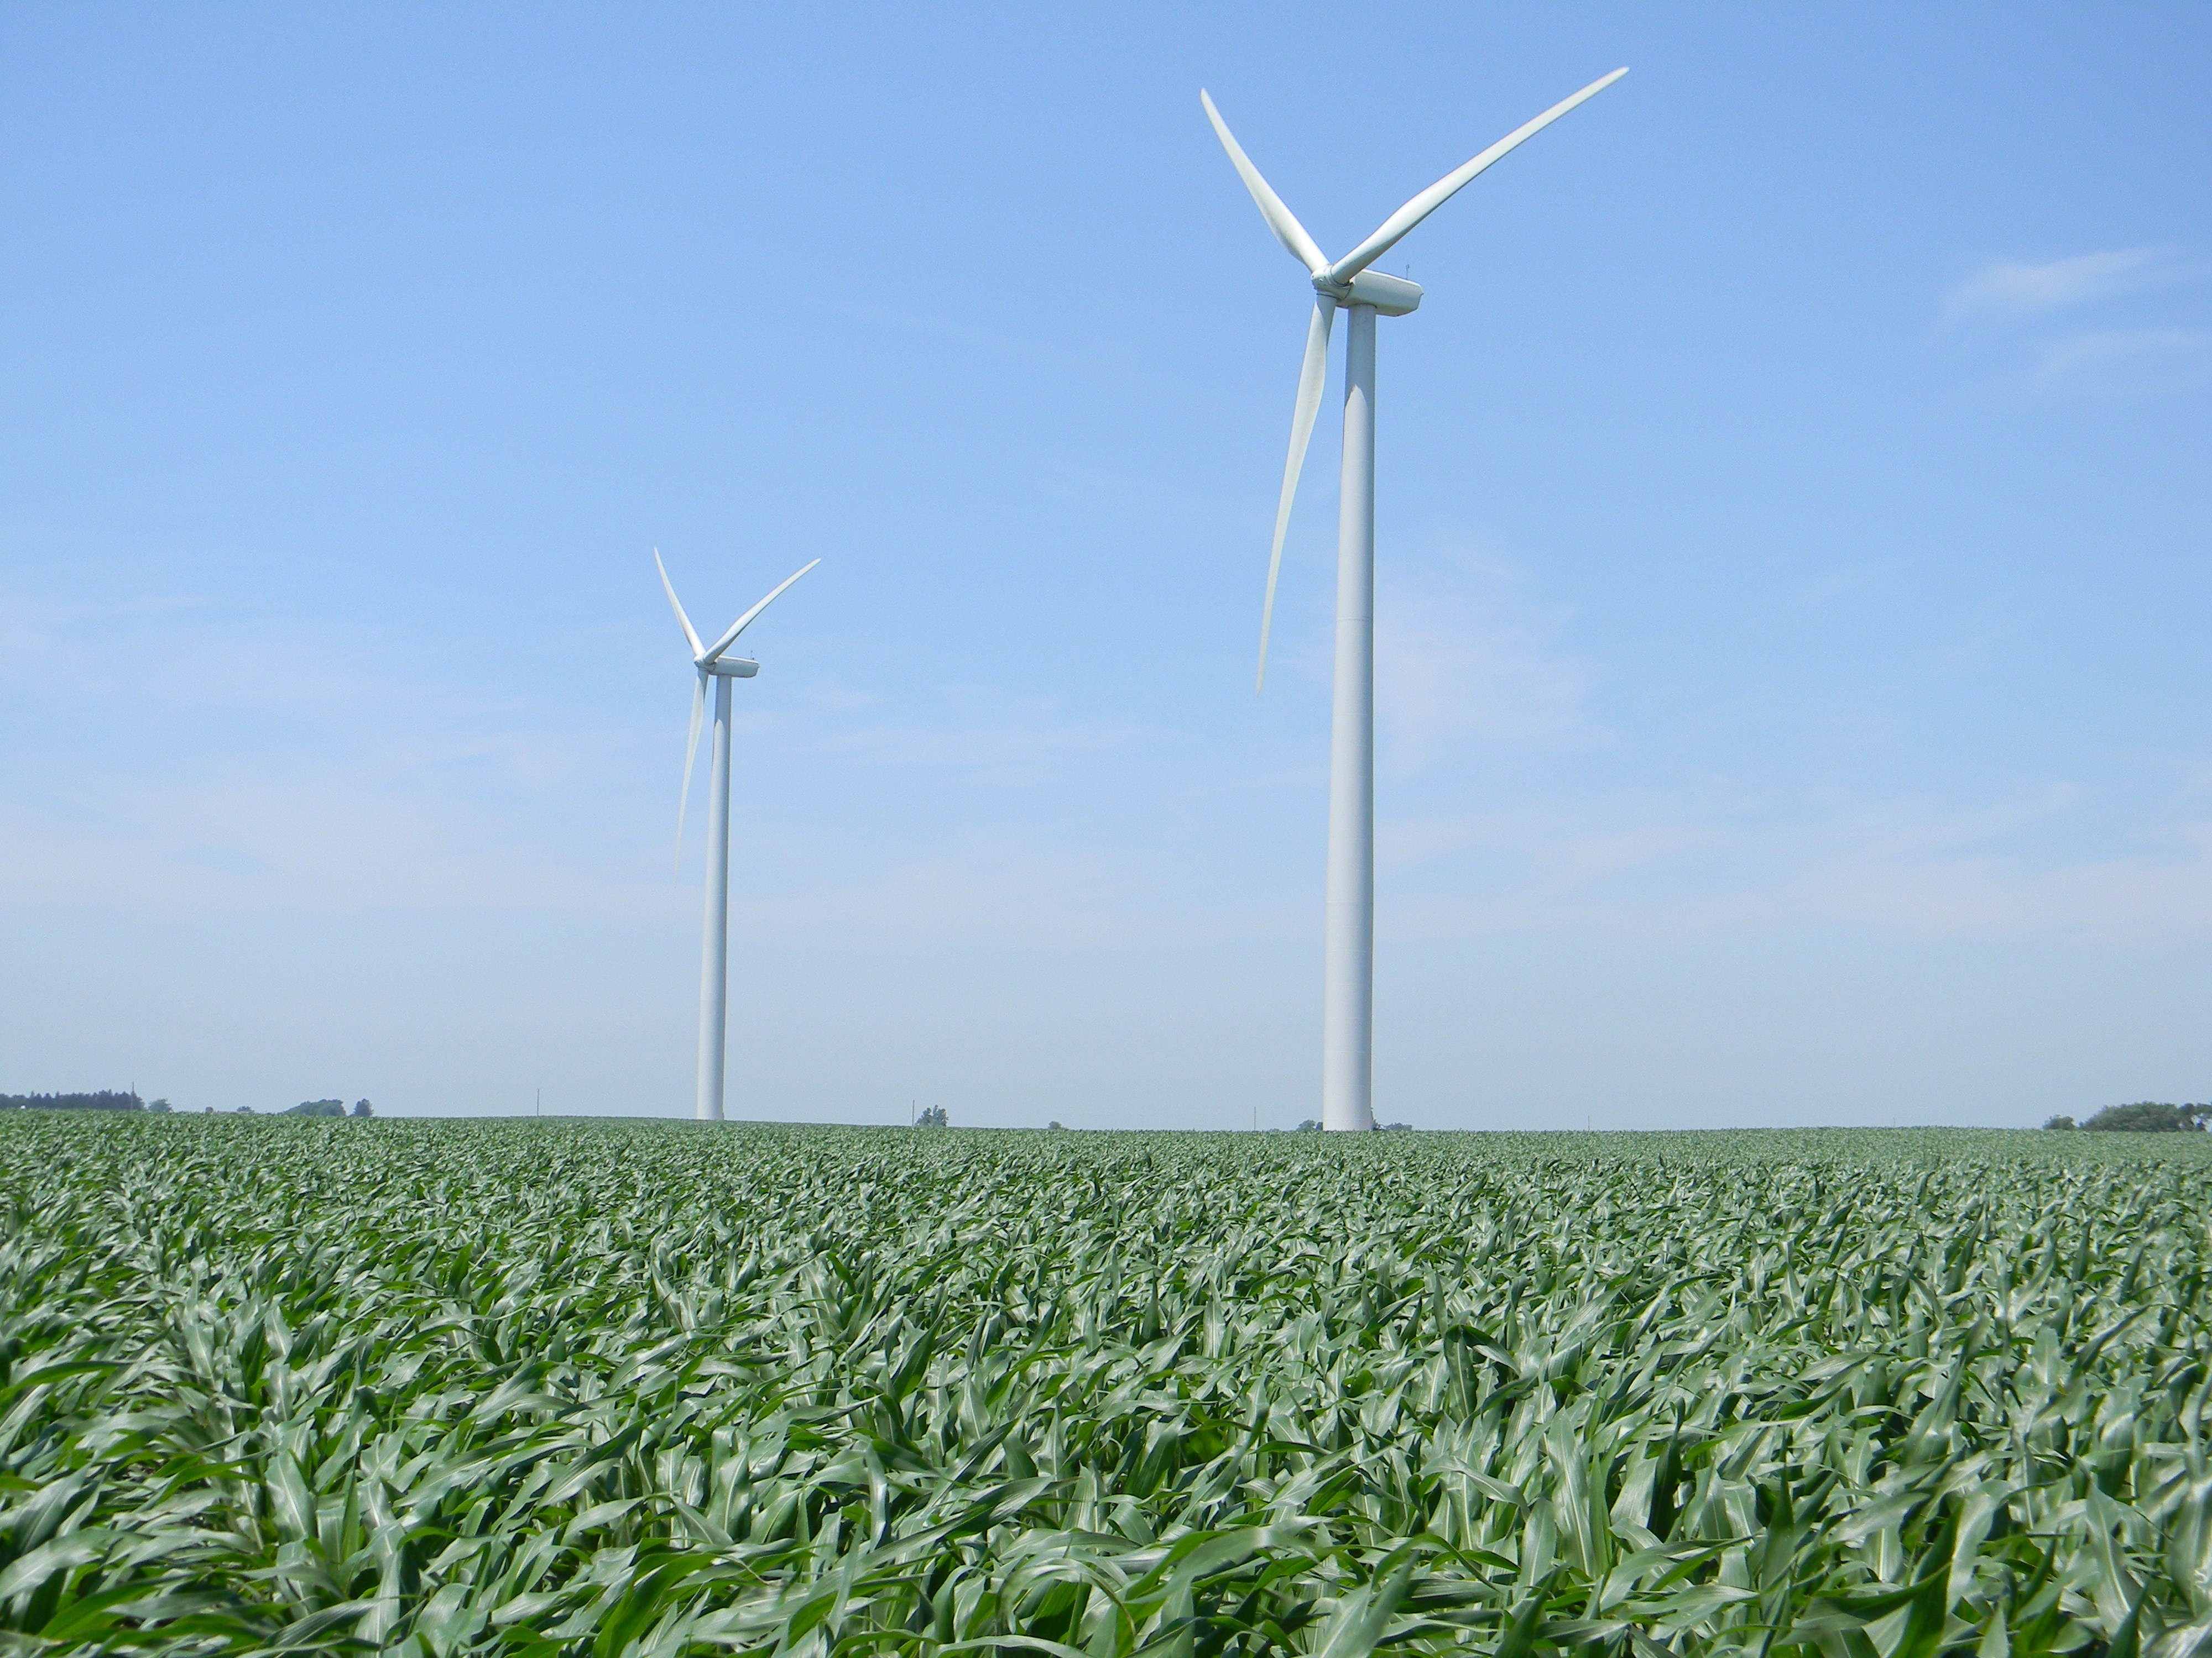
Wind Power:
An Attractive Source of Energy for Iowa and the US
Eugene S. Takle
Professor, Atmospheric Science
& Agricultural Meteorology
Director, Climate Science
Program
Iowa State University
Wind Webinar
East Iowa Community College
20 February 2013

Slide 2
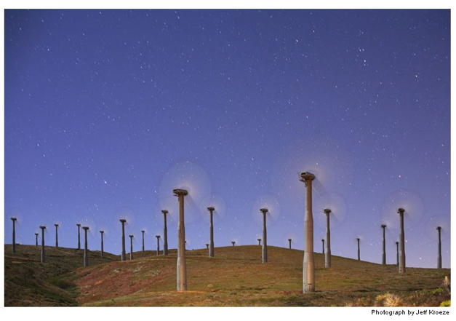
Outline
Why should we care?
Emerging importance of wind power
US wind energy resources
Iowa wind energy resources
Wind energy measurements and research

Slide 3
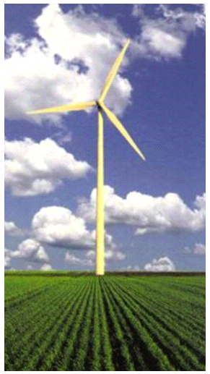
Wind Power
Wind is a clean (i.e., carbon-free, pollution-free) source of renewable energy
The US Department of Energy has a scenario of producing 20% of our energy supply from wind by 2030.
This will require 300 GW by 2030 (US installed capacity as of Sept 2012 was 60 GW)
Wind power, P ~ ρ V³

Slide 4
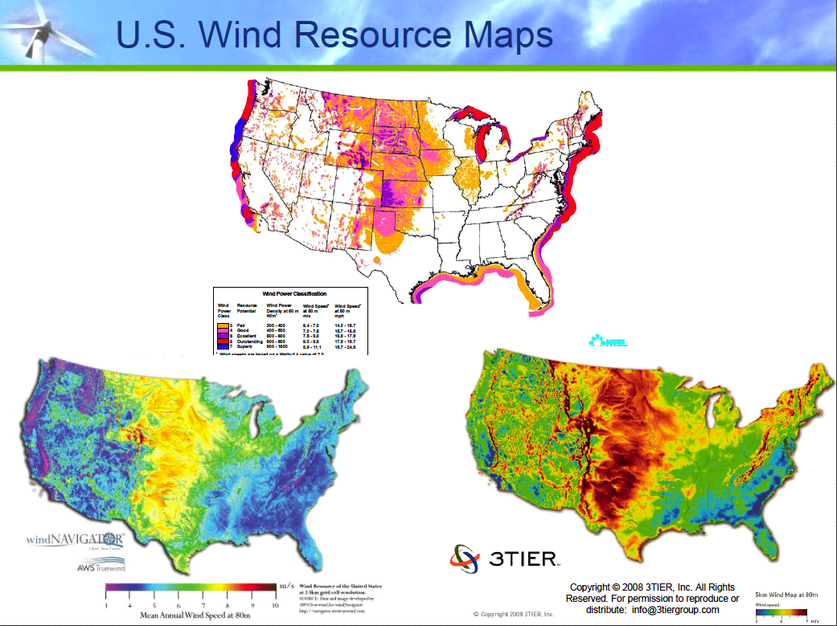

Slide 5
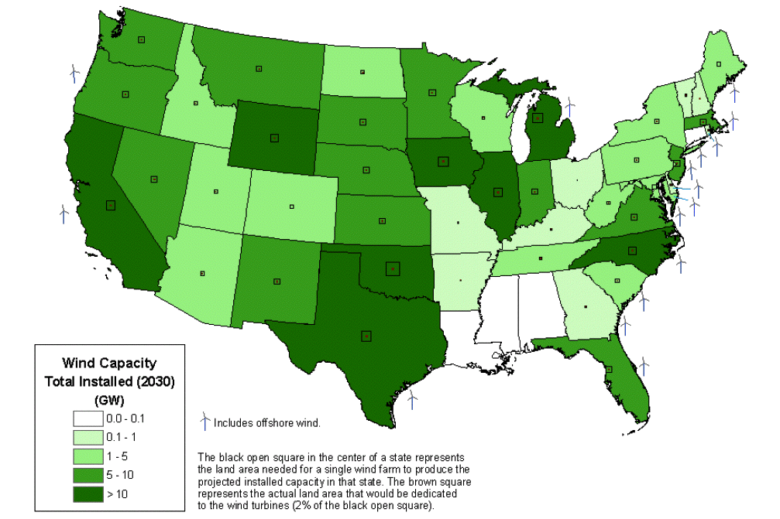

Slide 6
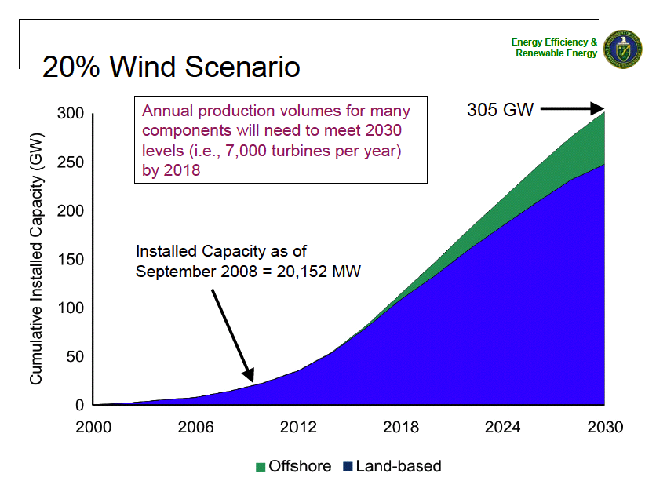

Slide 7
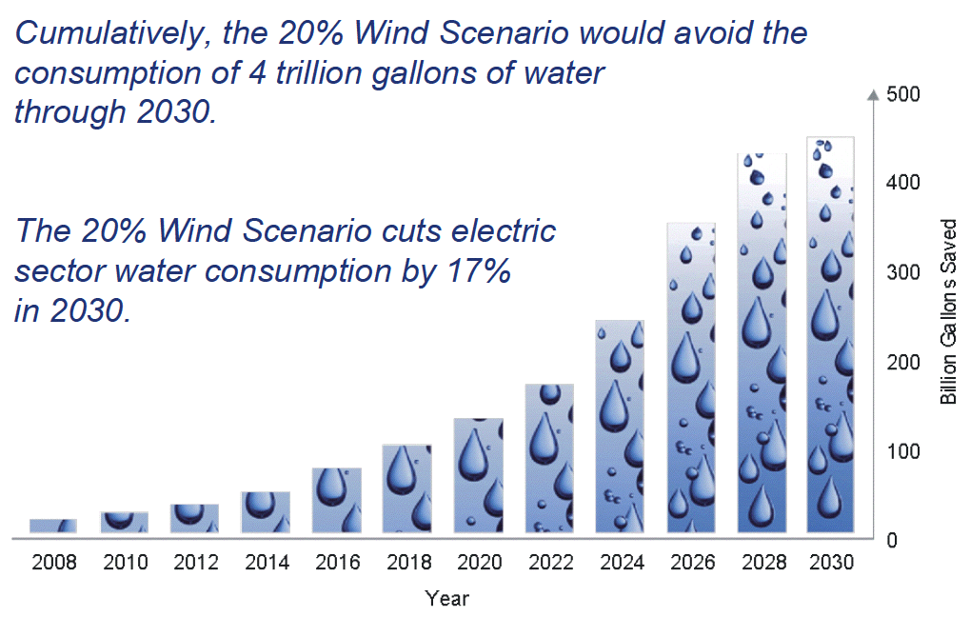

Slide 8
Low
High

Slide 9
Musial, W., and B. Ram, 2010: Large-scale Offshore Wind Power in the United States. Assessment of Opportunities and Barriers. NREL/TP-500-40745. 240 pp. [Available online at http://www.osti.gov/bridge]

Slide 11
Musial, W., and B. Ram, 2010: Large-scale Offshore Wind Power in the United States. Assessment of Opportunities and Barriers. NREL/TP-500-40745. 240 pp. [Available online at http://www.osti.gov/bridge]

Slide 12
Musial, W., and B. Ram, 2010: Large-scale Offshore Wind Power in the United States. Assessment of Opportunities and Barriers. NREL/TP-500-40745. 240 pp. [Available online at http://www.osti.gov/bridge]

Slide 13
Musial, W., and B. Ram, 2010: Large-scale Offshore Wind Power in the United States. Assessment of Opportunities and Barriers. NREL/TP-500-40745. 240 pp. [Available online at http://www.osti.gov/bridge]

Slide 14
Musial, W., and B. Ram, 2010: Large-scale Offshore Wind Power in the United States. Assessment of Opportunities and Barriers. NREL/TP-500-40745. 240 pp. [Available online at http://www.osti.gov/bridge]

Slide 17
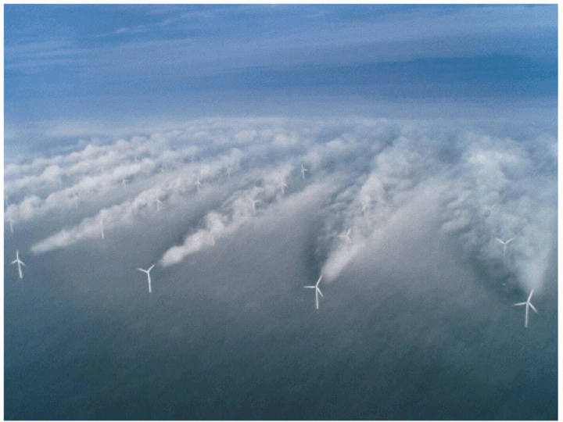
Source: UniFly A/S
Horns Rev 1 owned by Vattenfall. Photographer Christian Steiness.

Slide 18
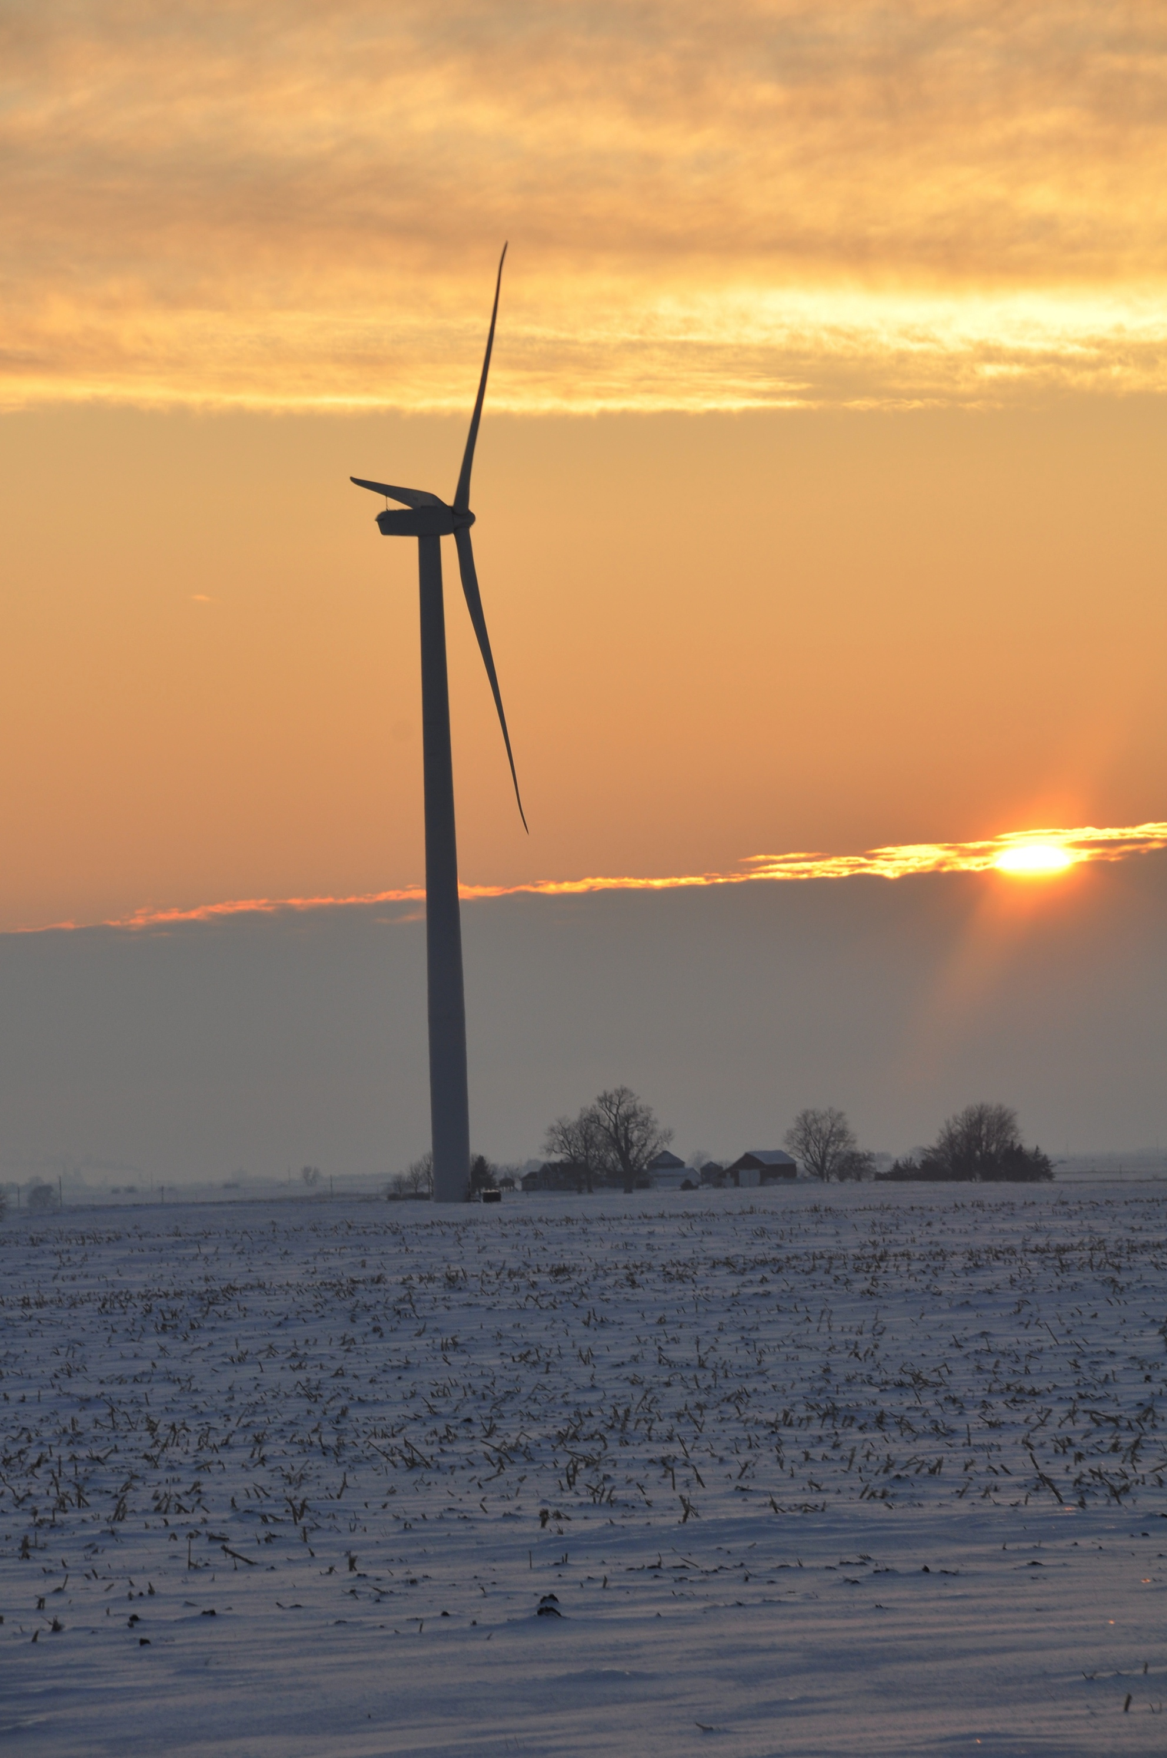
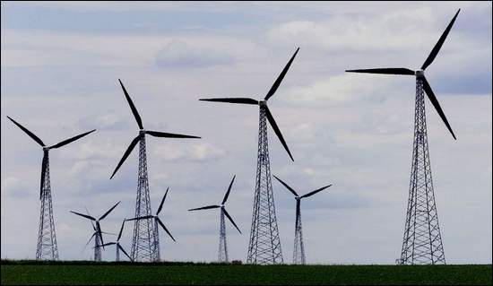
Iowa’s Contribution
Iowa ranks third behind Texas and California among all states in wind generation with 5.137 GW of operating capacity (~3,000 wind turbines)

Slide 19
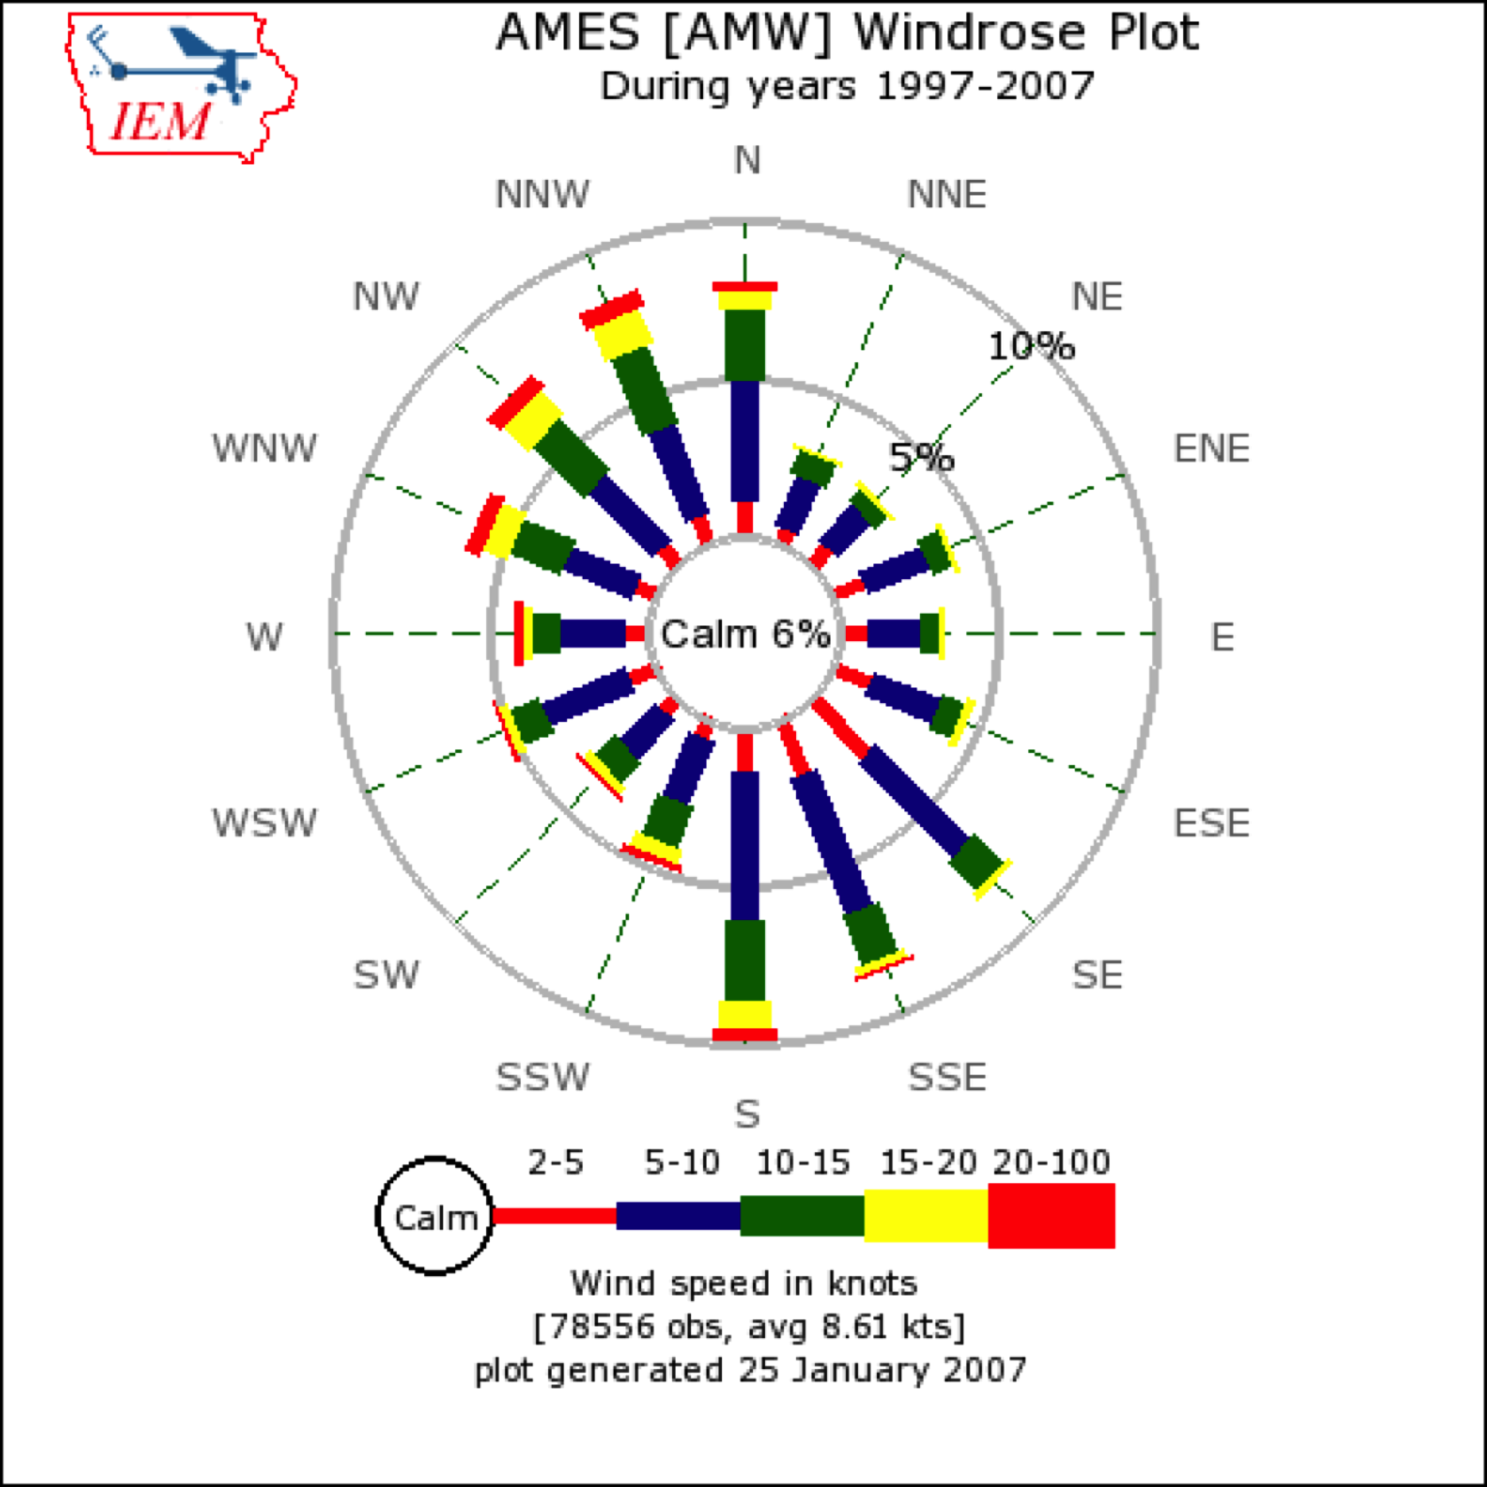

Slide 20
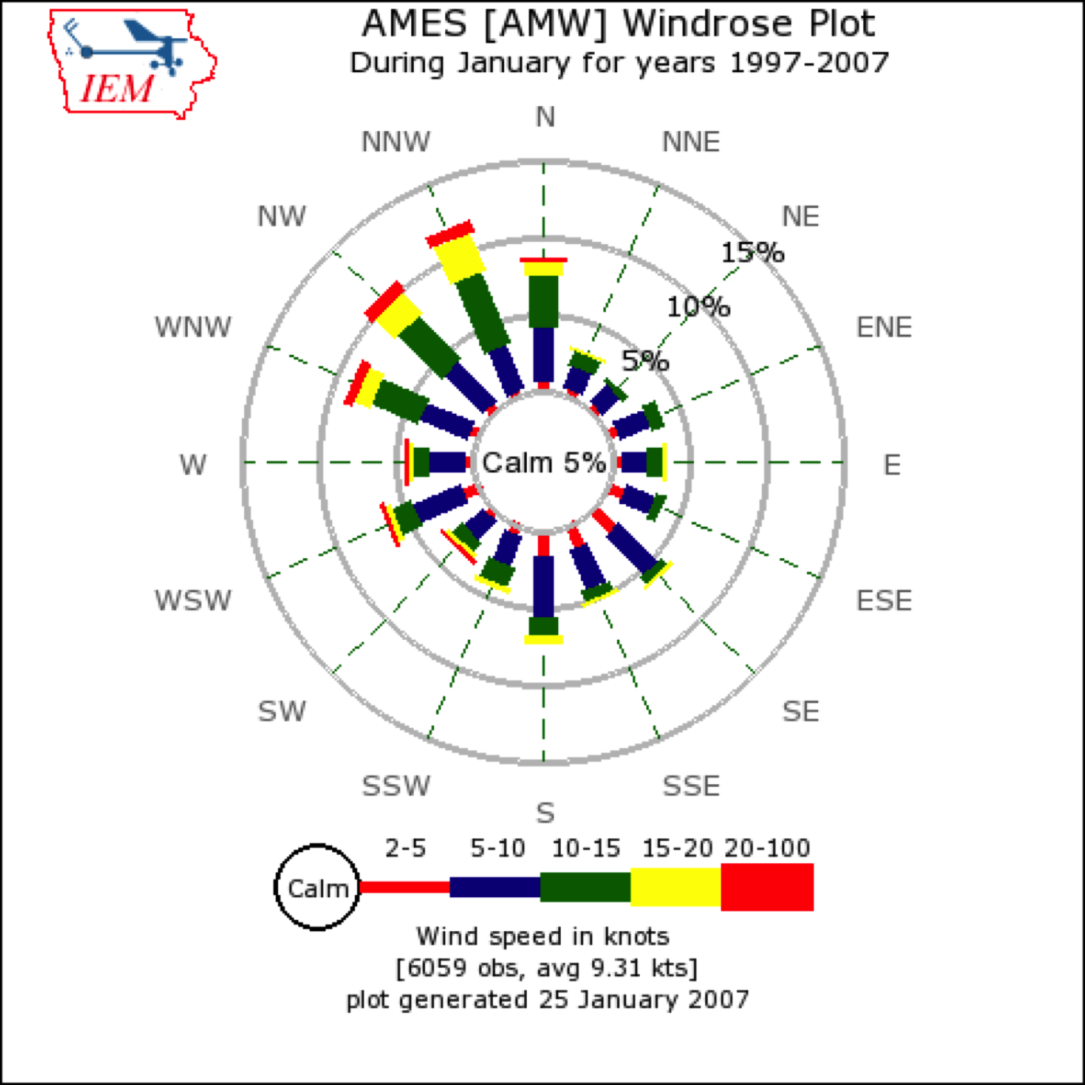

Slide 21
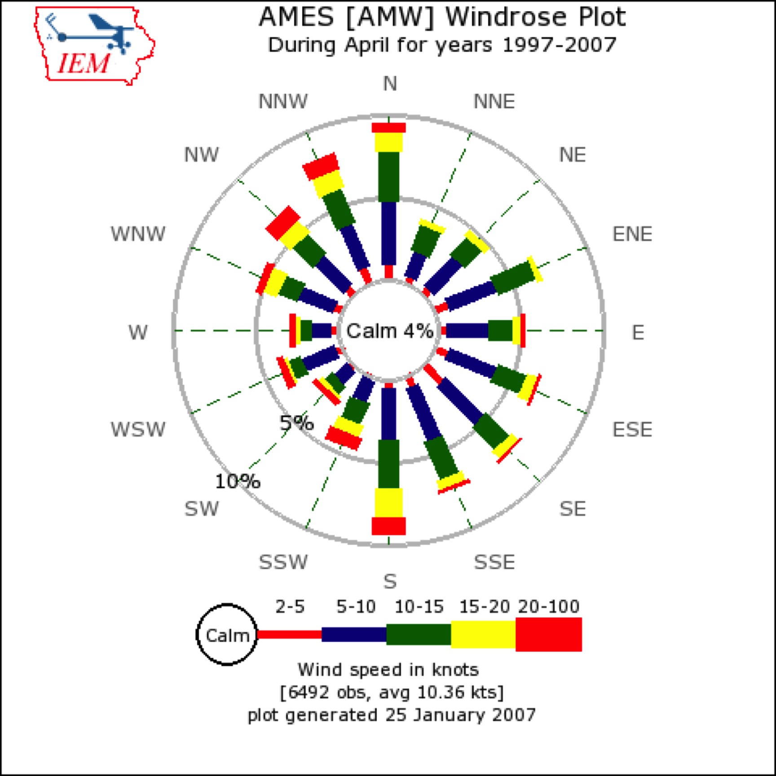

Slide 22
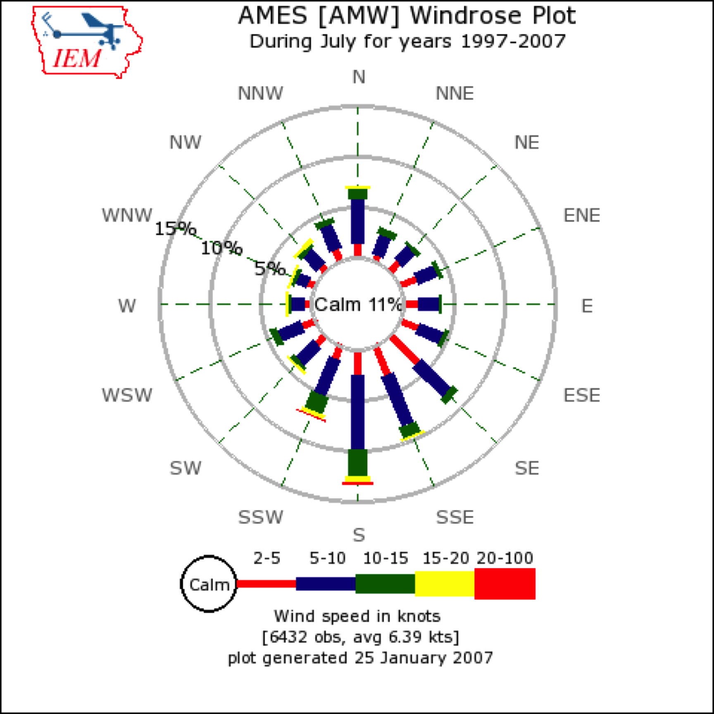

Slide 23
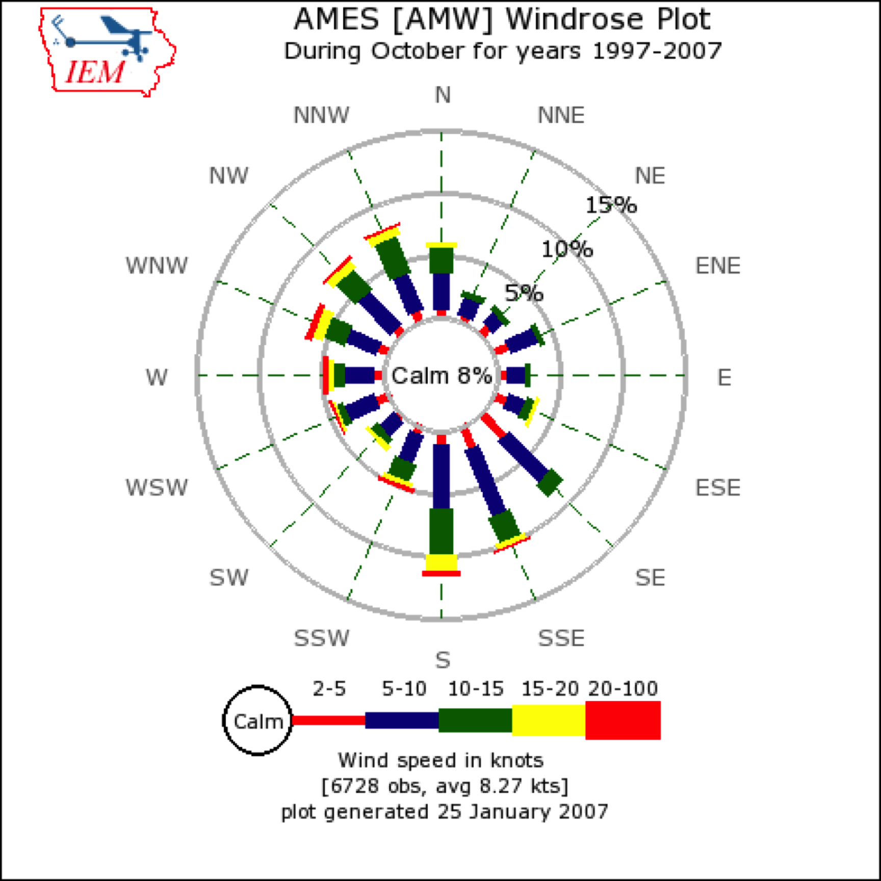

Slide 24
Number of Occurrences
2
4
6
8
10
12
14
16
18
20
22
Winspeed (m/s)

Slide 25
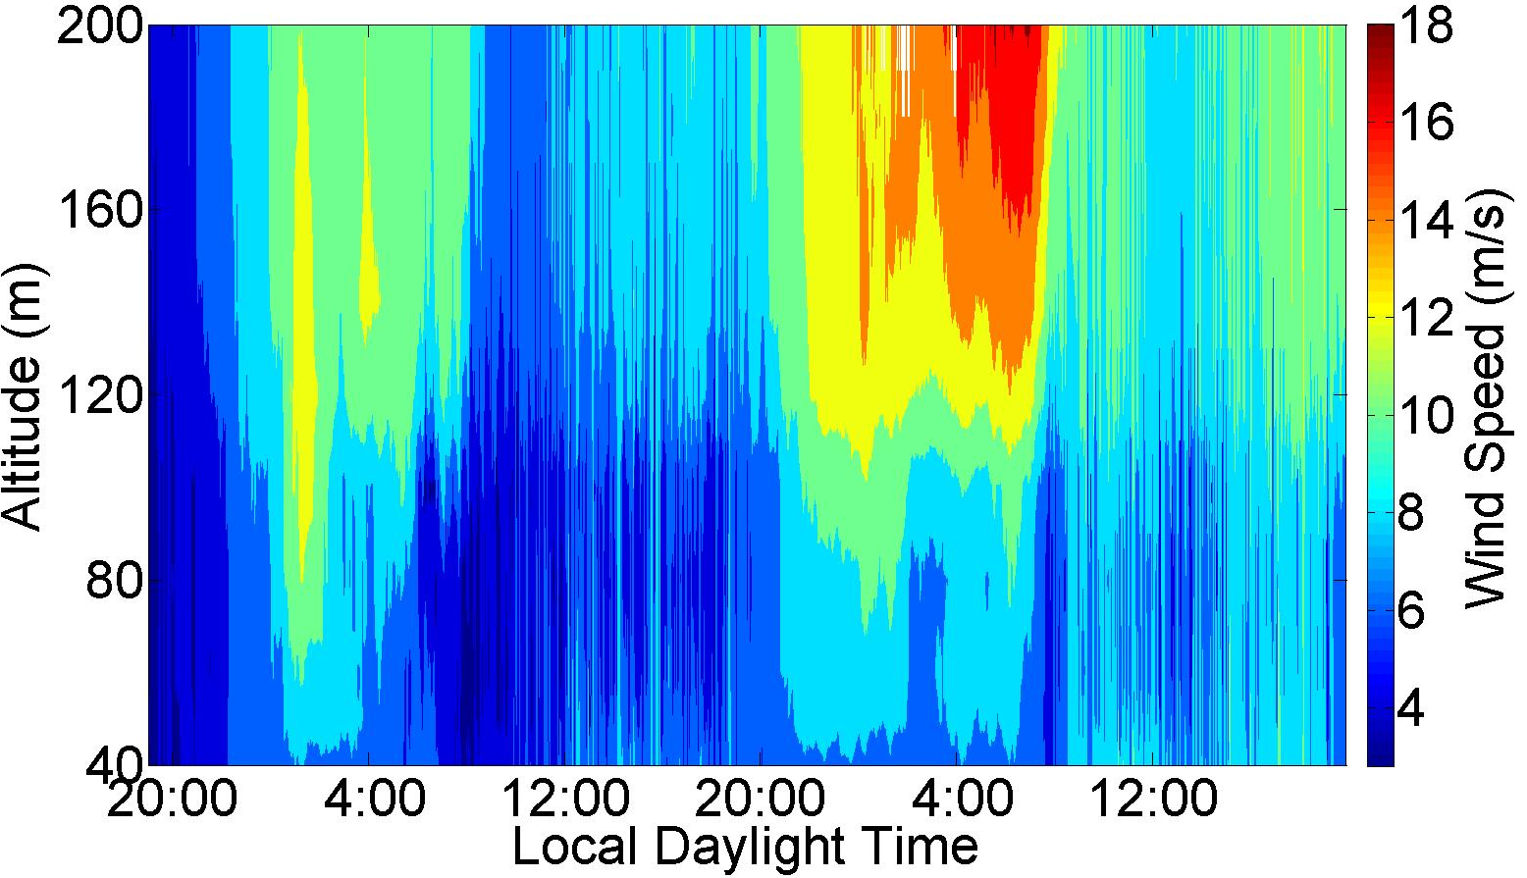
Observed wind speed profiles (Windcube lidar, summer, Midwest US) exhibit more variability than is traditionally considered in CFD
LLJ Max
~ 16 m/s
And these are “typical” midwestern conditions!
LLJ Max
~ 12 m/s
Turbine Wake
Rhodes, Aitken, Lundquist, 2010, 2011
Julie.Lundquist@colorado.edu

Slide 26
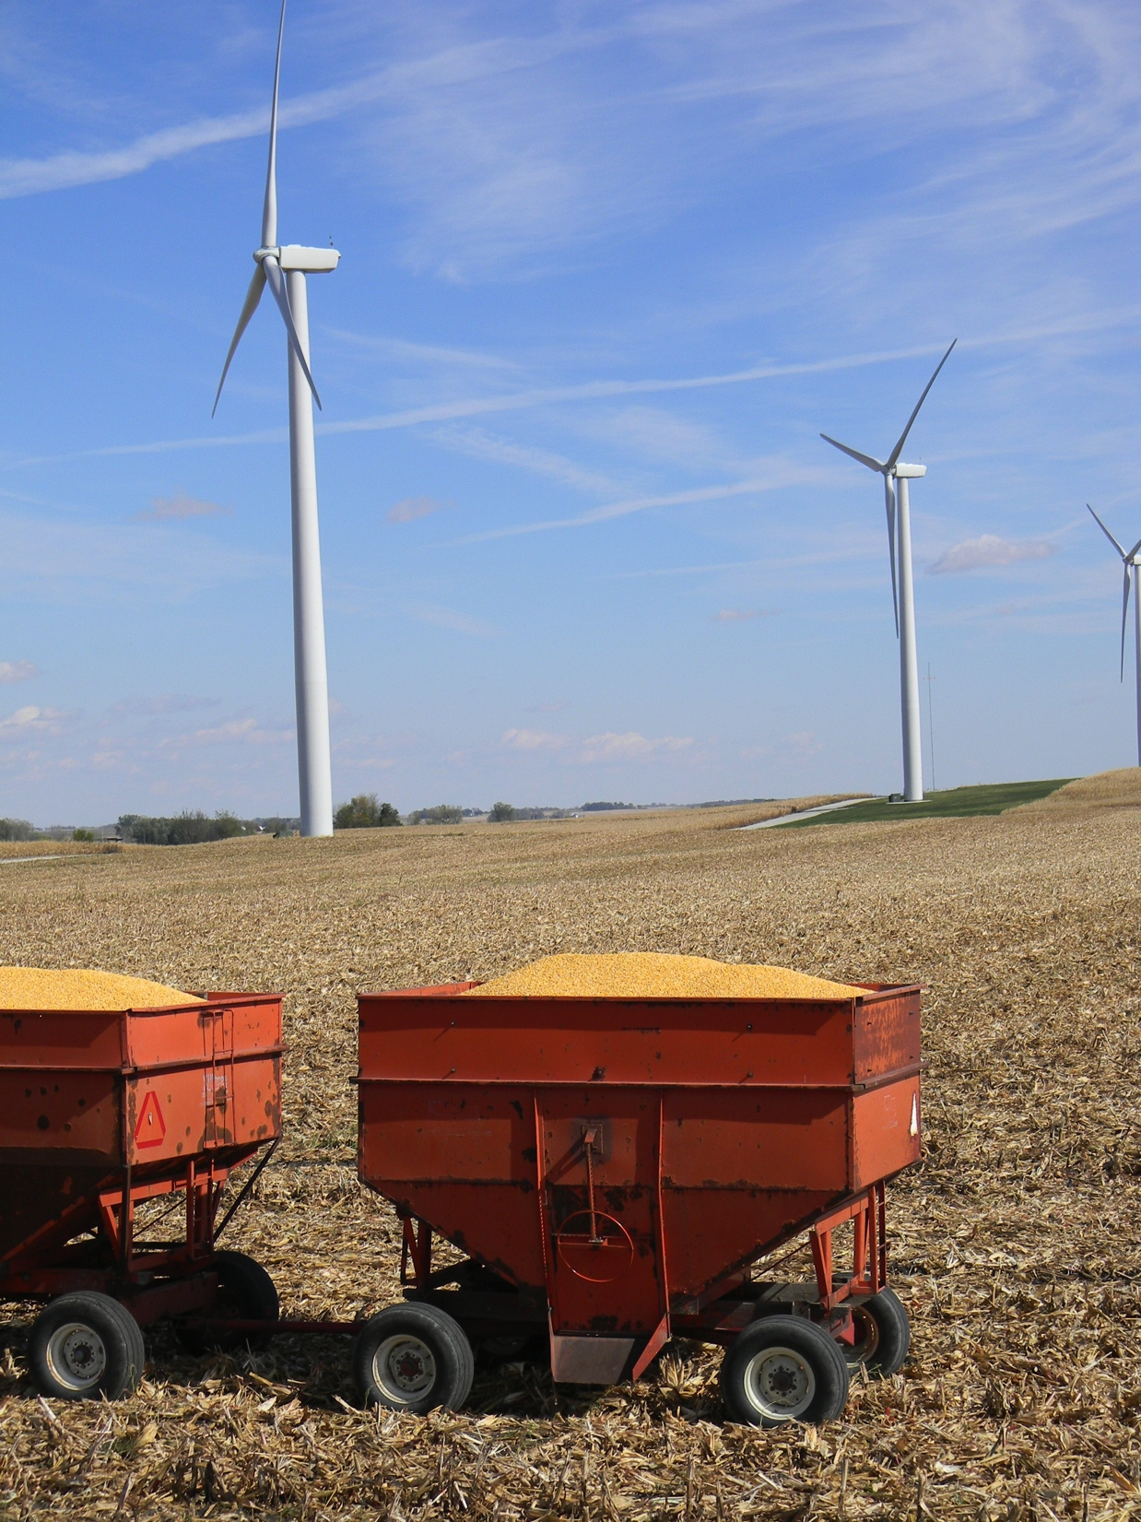
Need Better Estimates of Wind Speed
for Forecasting Wind Power
“Given that a 1% error in wind speed estimates for a 100 MW wind generation facility can lead to losses approaching $12,000,000 over the lifetime of that plant, a better understanding of the physical and dynamic processes across the range of scales that create a particular wind climate is needed.”
Draft recommendations, DOE Workshop on Research Needs for Wind Resource Characterization, 14-16 Jan 2008, Broomfield, CO
Iowa will have 5,317 MW installed by 2012, so a 1% error is $212 million over its lifetime.

Slide 27
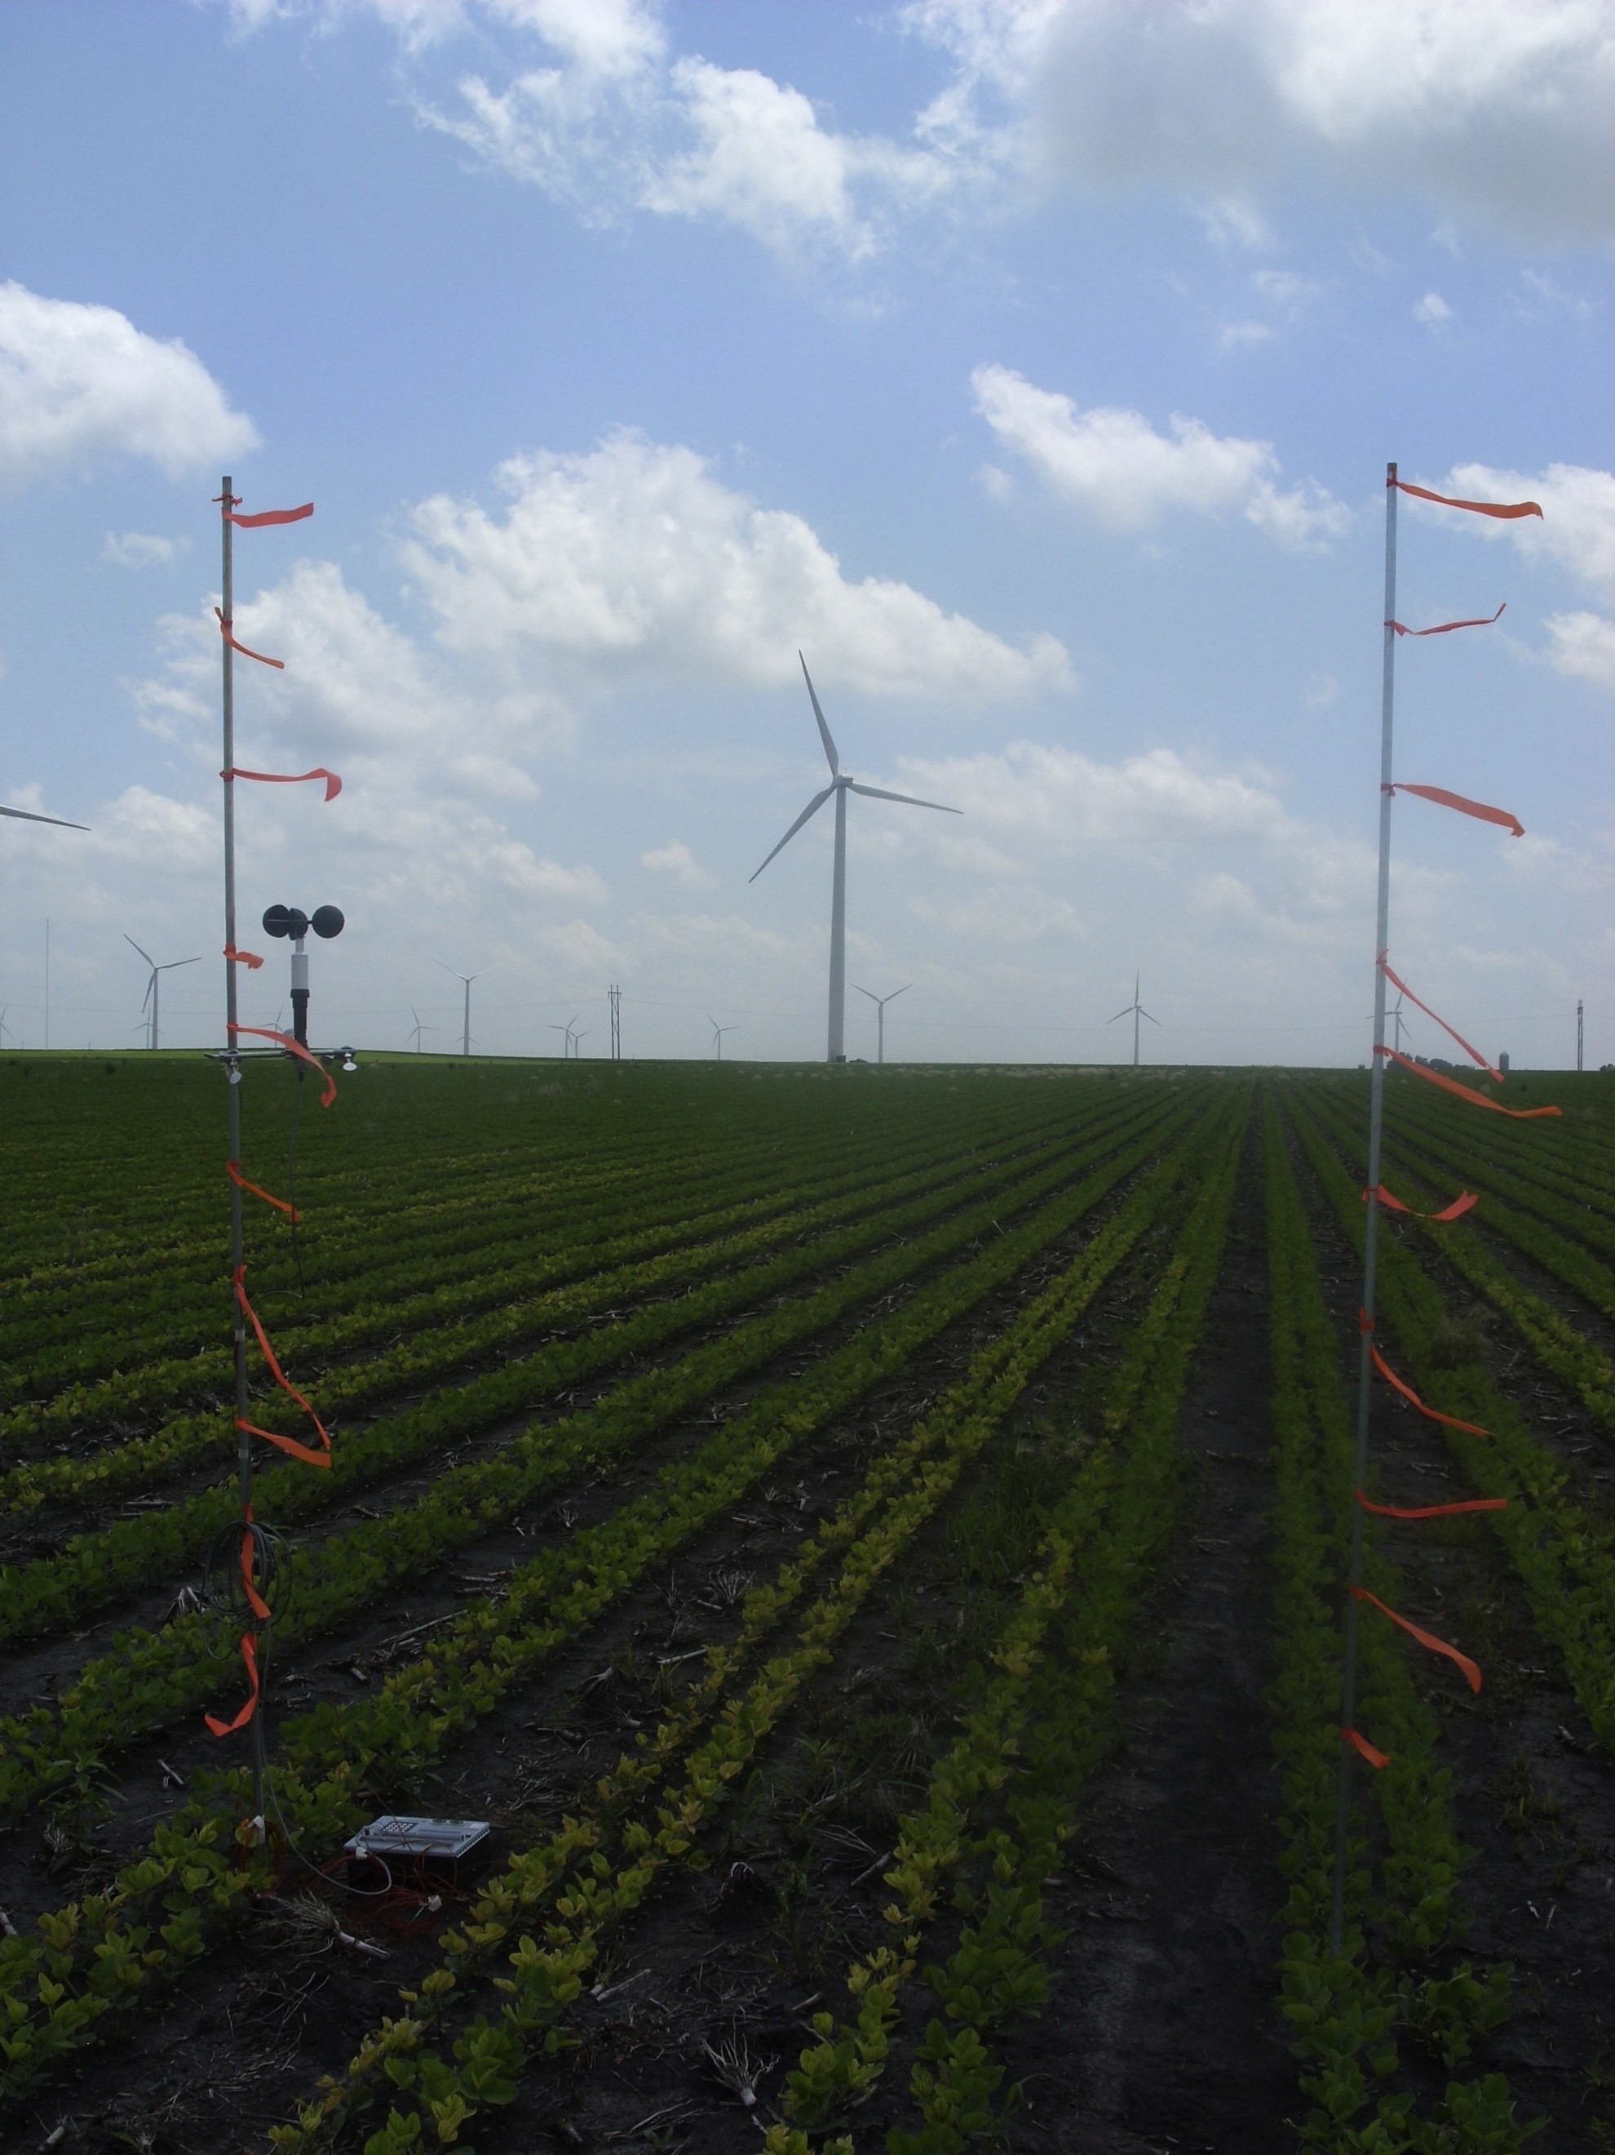
What Turbine Density Optimizes Wind Power Production and Agricultural Production?

Slide 28
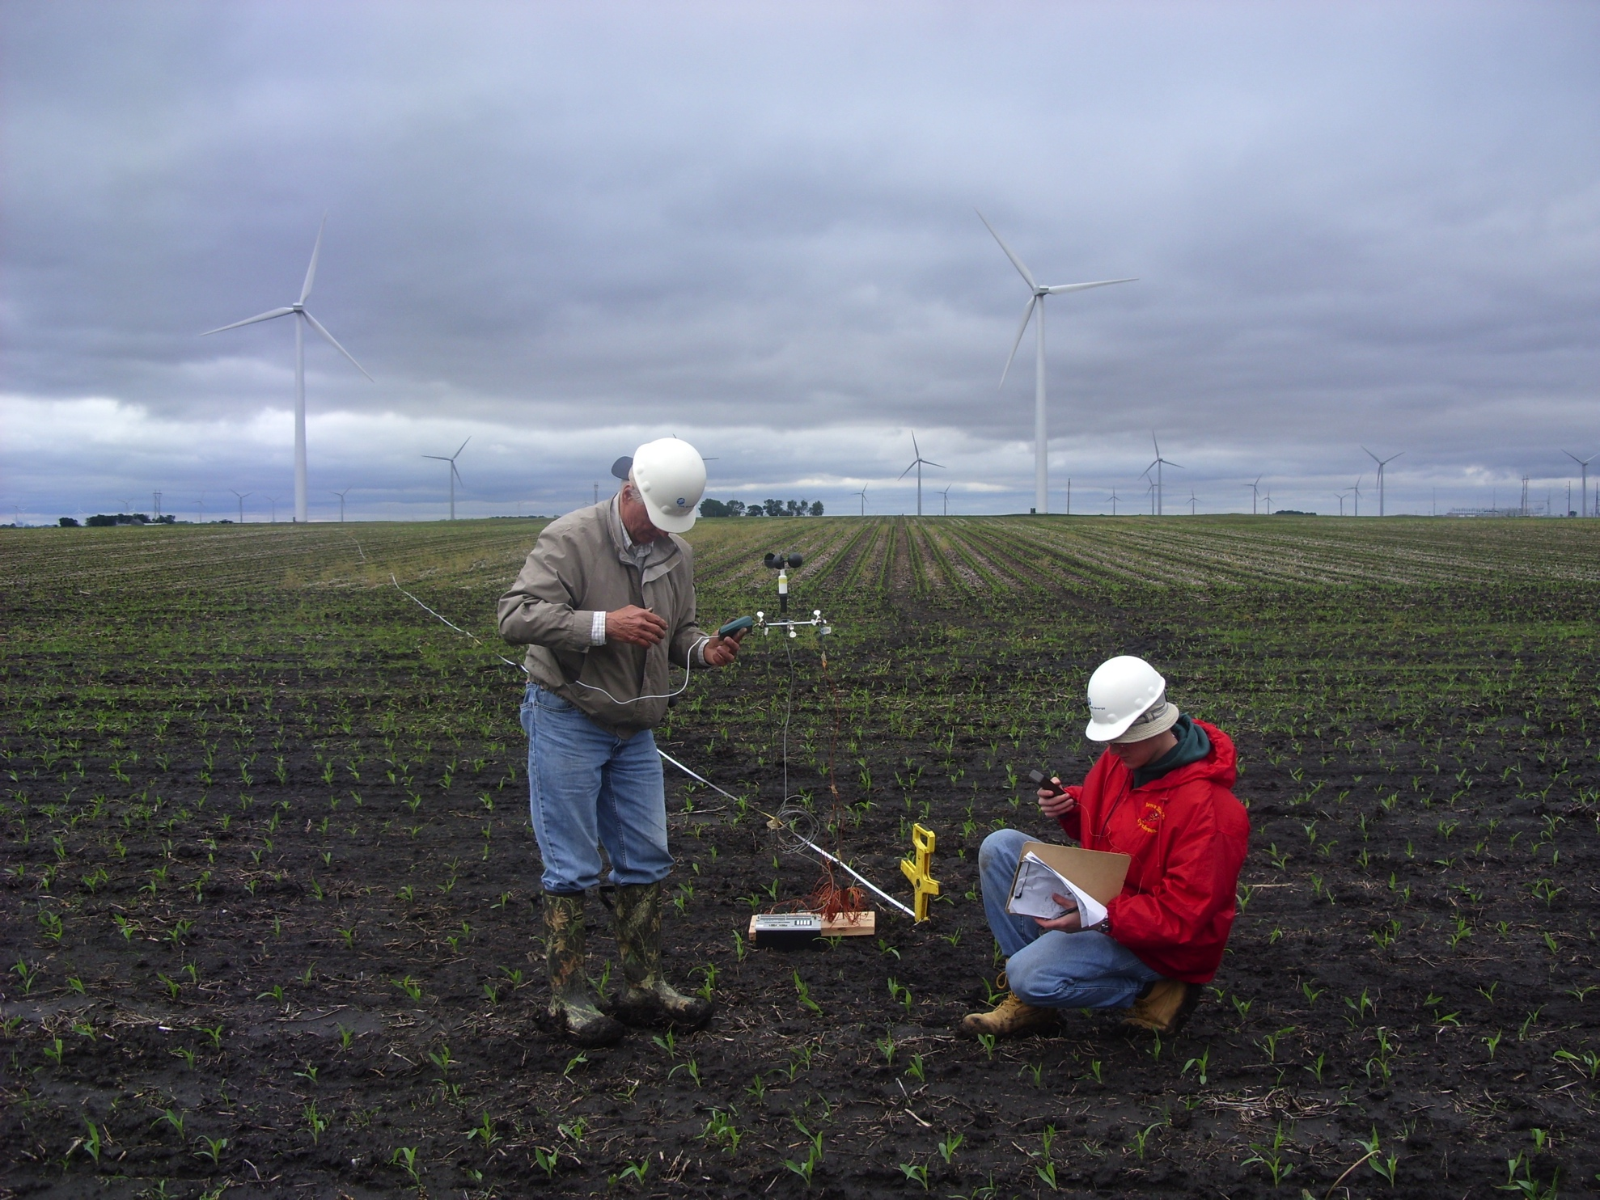
Preliminary Observations

Slide 29
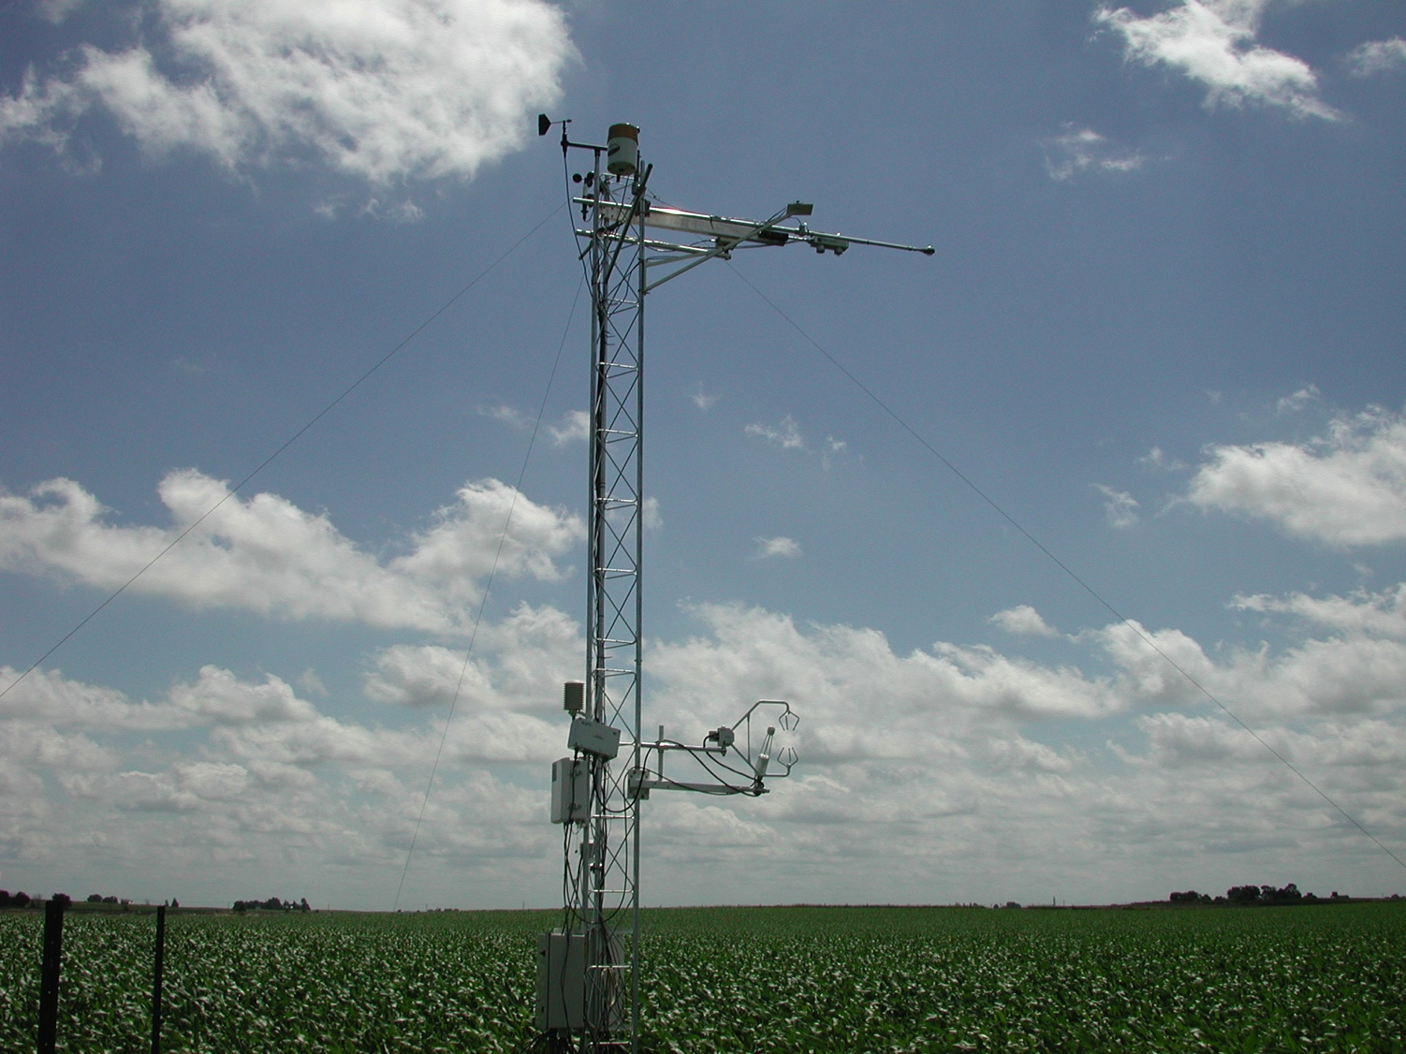

Slide 30
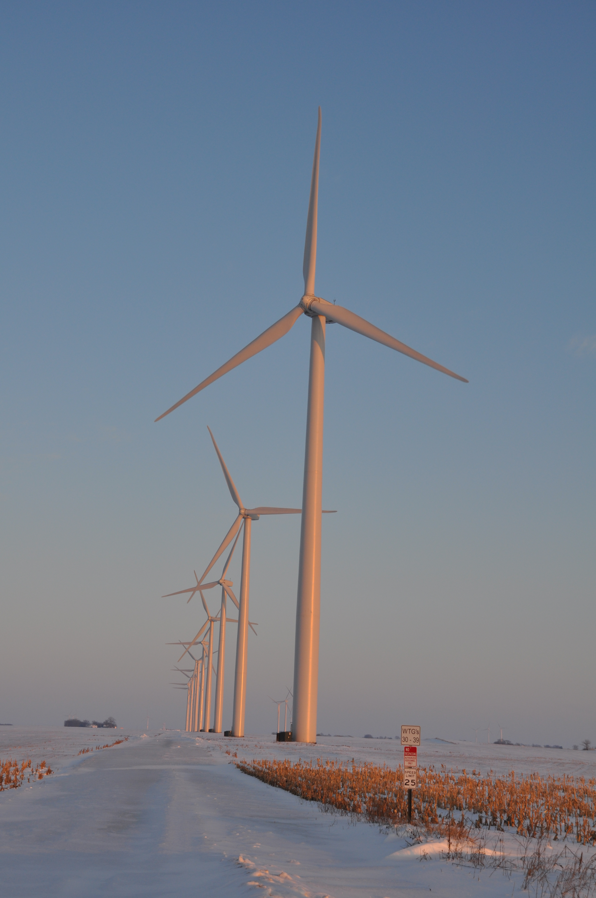
Turbine-Crop Interactions:
Overview
Do turbines create a measureable influence on the microclimate over crops?
If so, is this influence create measureable biophysical changes?
And if this is so, does this influence affect yield?
Agricultural shelterbelts have a positive effect on crop growth and yield.
Will wind turbines also have a positive effect?
Photo courtesy of Lisa H Brasche

Slide 31
Conceptual Model of Turbine-crop Interaction via Mean Wind and Turbulence Fields
Speed recovery
day
H₂O
CO₂
Heat
__ ___________________________________
night

Slide 32
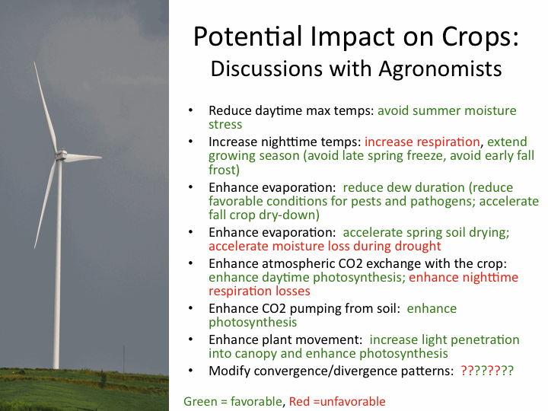
Photo courtesy of Lisa H Brasche

Slide 33
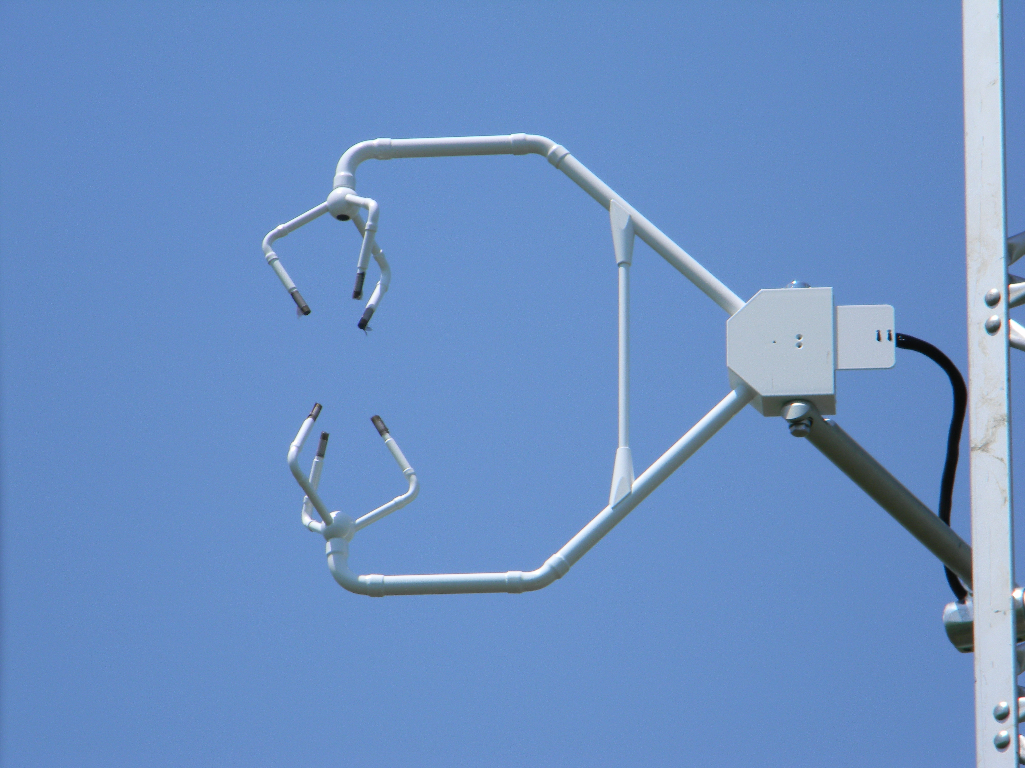

Slide 34
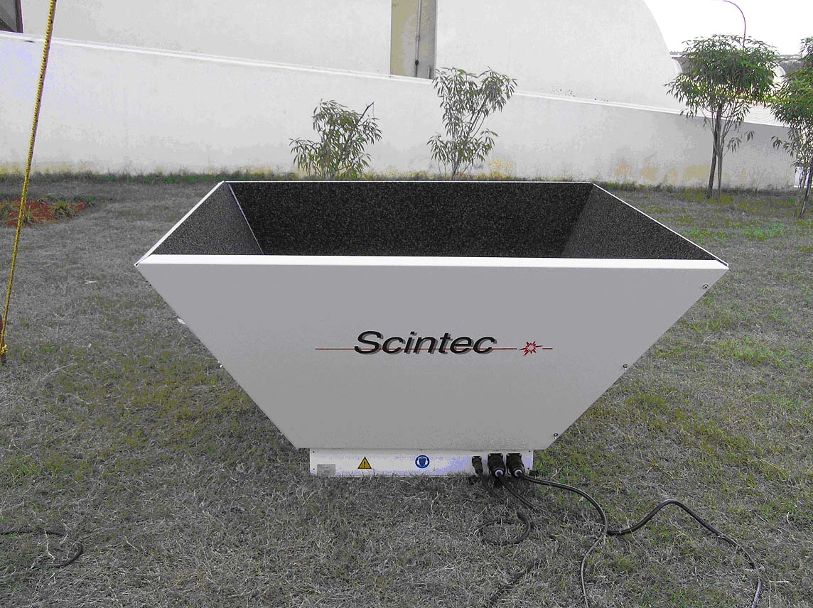

Slide 35
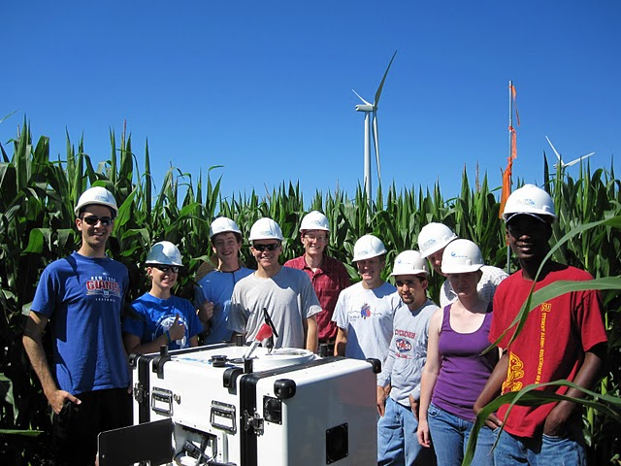

Slide 36
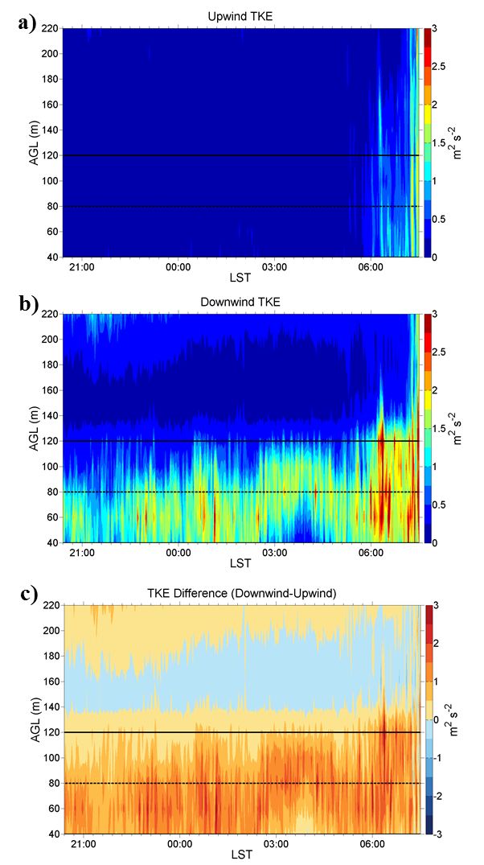
Vertically Pointing Lidar
Vertical profiles of turbulence kinetic energy (TKE)
16-17 July 2010
4.5 D South of B-turbines
Rotor Layer
2.0 D North of B-turbines
CU/NREL/ISU Lidar deployment team
TKE difference

Slide 37
Measuring Wind Speed, Wind Direction, Temperature, and Turbulence with a Tethered Balloon

Slide 38
Measuring Wind Speed, Wind Direction, Temperature, and Turbulence with a Tethered Balloon

Slide 39
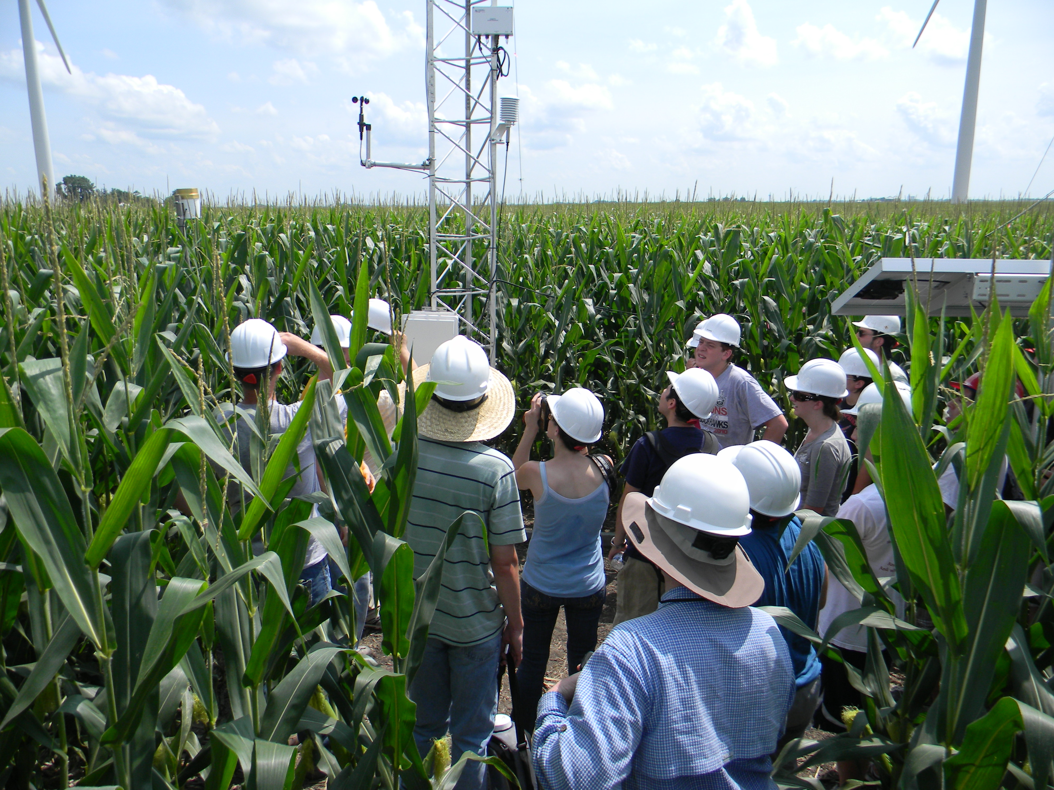
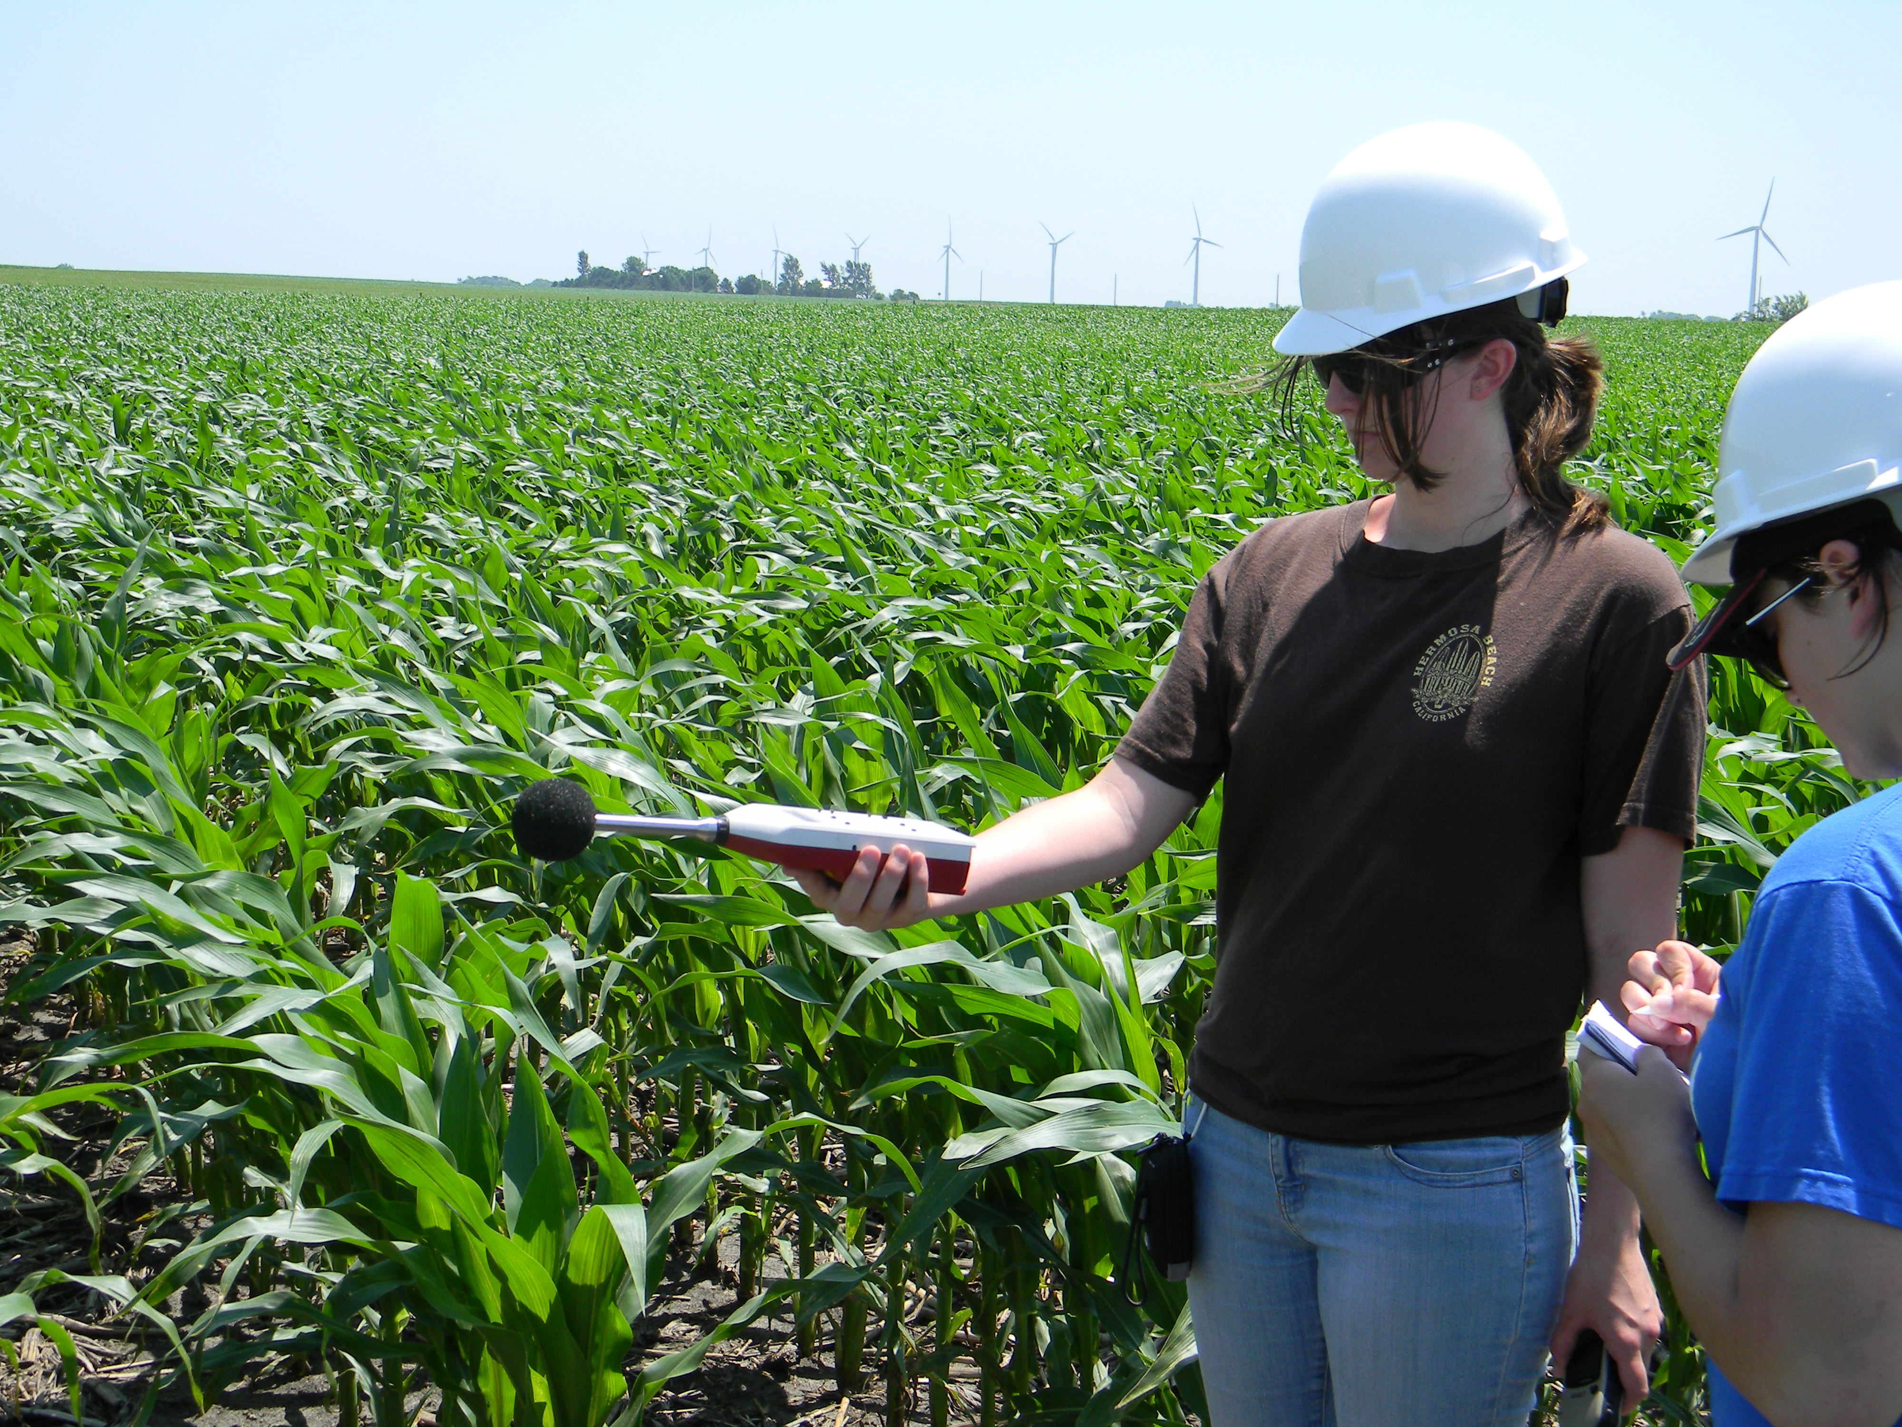
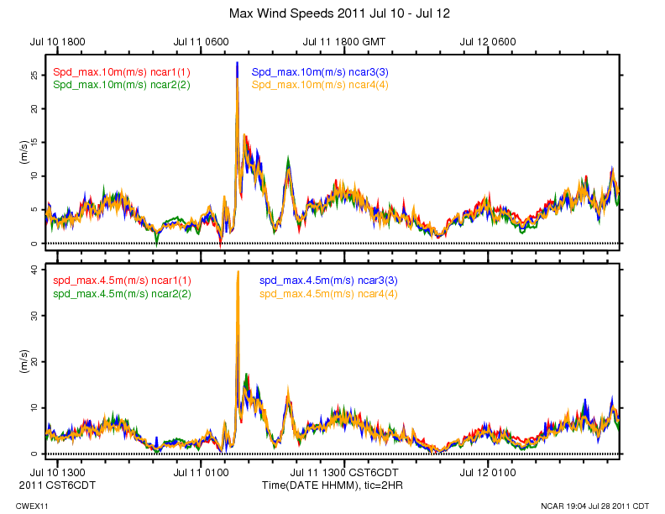
CWEX11
REU student short course in field measurements
NCAR station records 40 m/s (89 mph)wind on 11 July
REU students measure noise levels in the wind farm

Slide 40
Summary
The US has a very large wind energy resource potential
Iowa also has strong energy resources
Current research is seeking answers to
  How wind farms interact with crops
  How to get more energy out of existing wind farms
Wind energy has a good future in Iowa and provides a promising career for new graduates

Slide 41
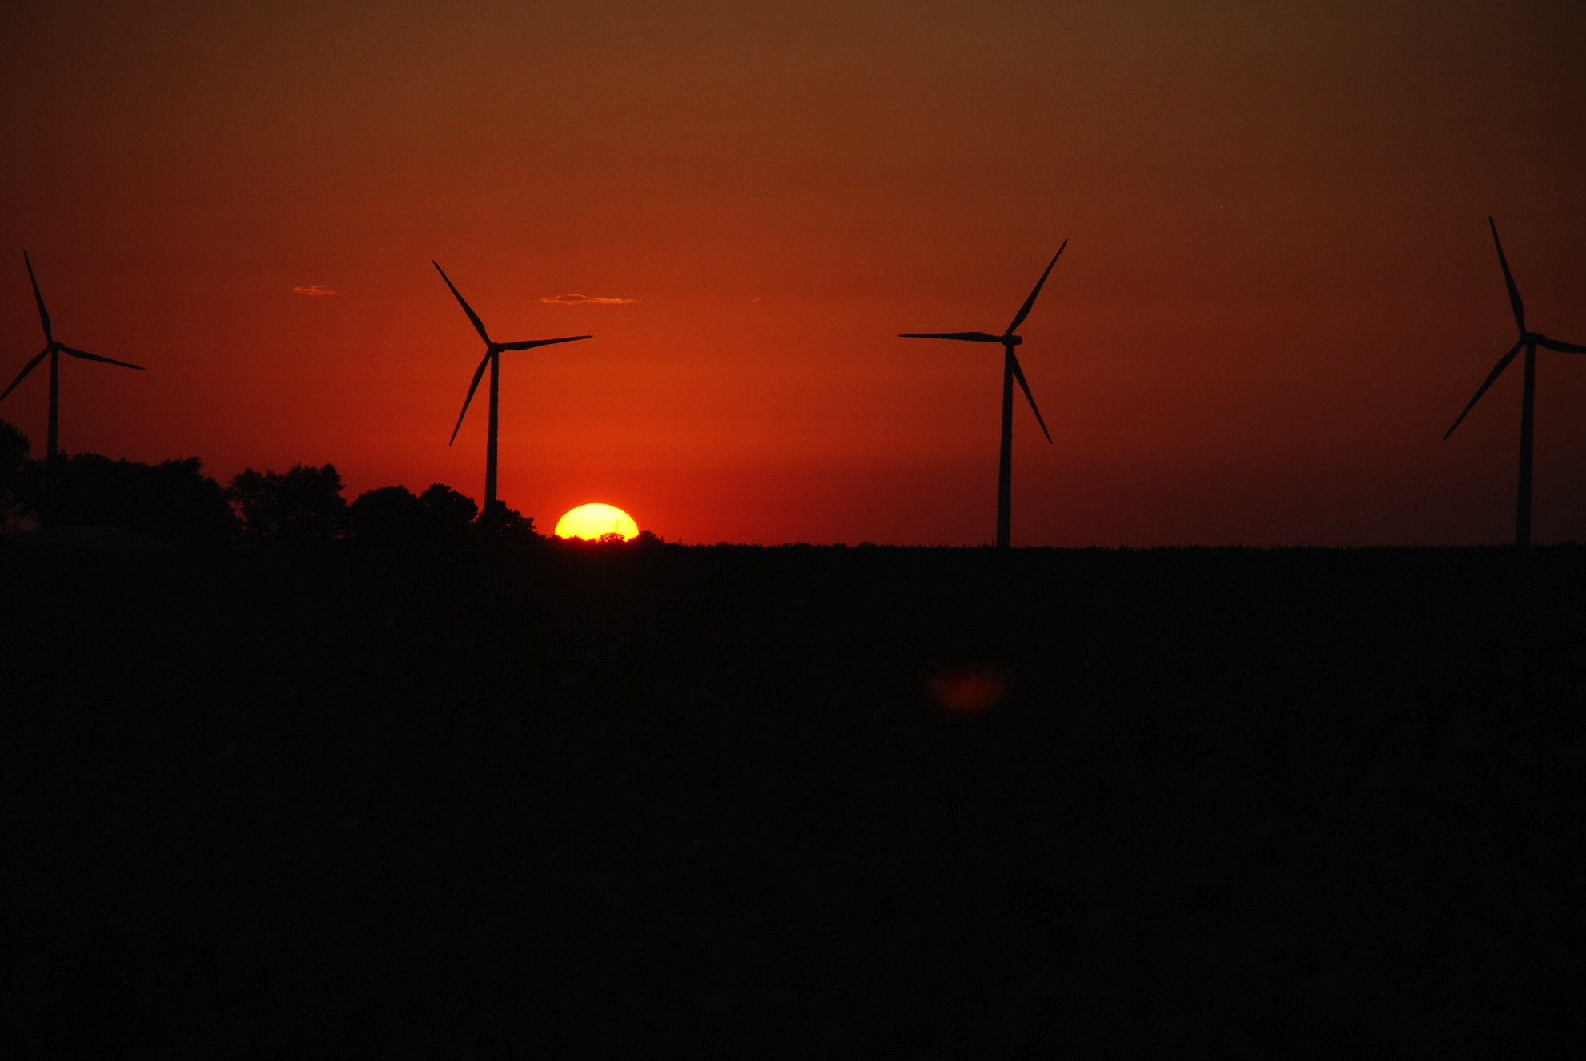
ACKNOWLEDGMENTS
Julie Lundquist for slides from presentation at LANL
Dr. Ron Huhn, property owner
Gene and Todd Flynn, farm operators
Lisa Brasche for photos
Equipment and personnel supplied by the National Laboratory for Agriculture and
the Environment
Funding supplied by
Center for Global and Regional Environmental Research, University of Iowa
MidAmerican Energy Company
Ames Laboratory , Department of Energy
National Science Foundation
Photo courtesy of Lisa H Brasche

Slide 42
For More Information
Eugene S. Takle
gstakle@iastate.edu
http://www.meteor.iastate.edu/faculty/takle/
515-294-9871
Photo courtesy of Lisa H Brasche

Slide 43
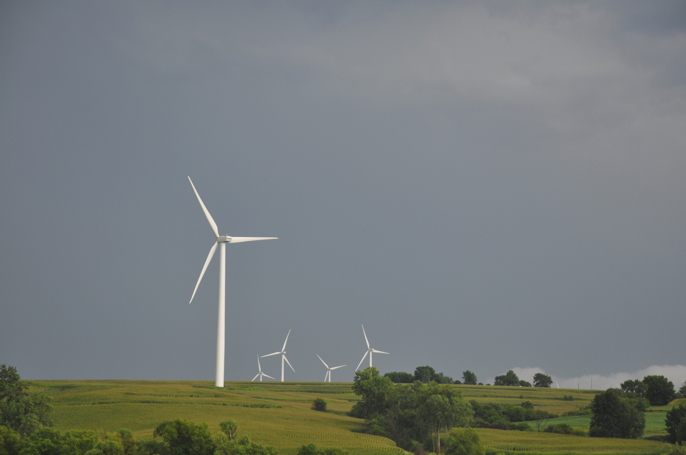
Photo courtesy of Lisa H Brasche

Slide 44
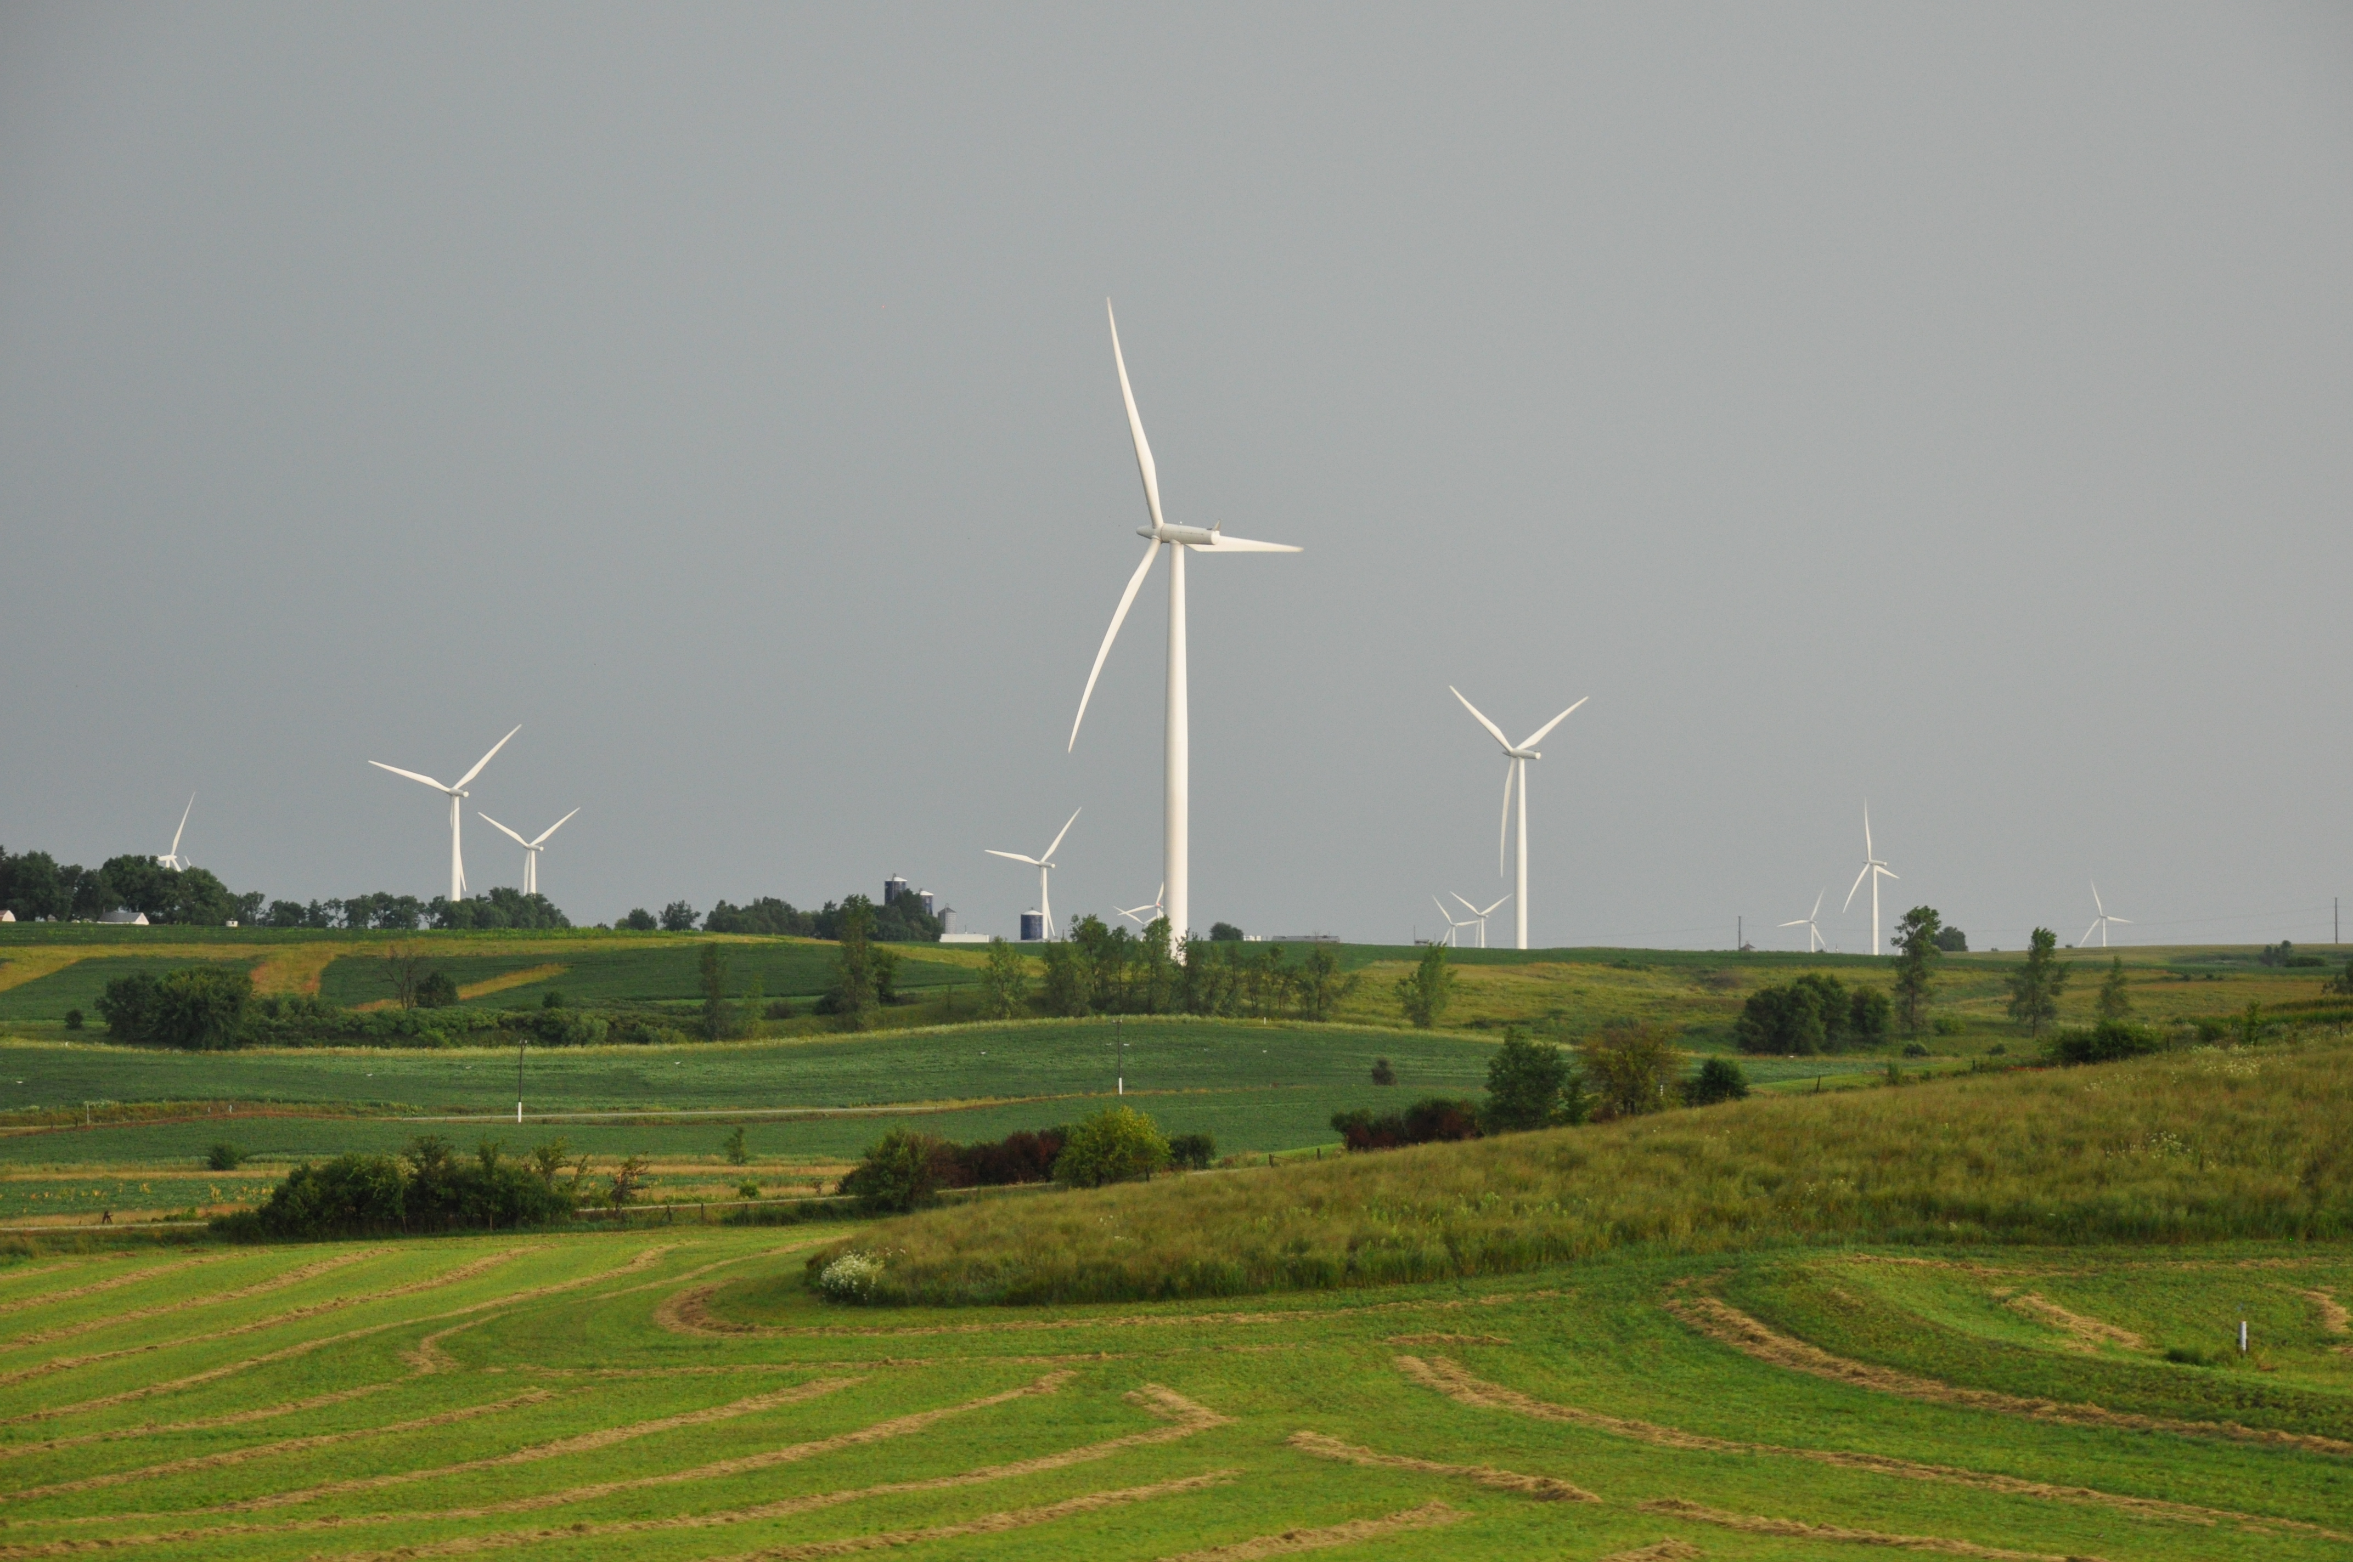
Photo courtesy of Lisa H Brasche

